Slide 1

Digital Accessibility
Create an Inclusive and Accessible Experience
Accessible Colors

Slide 2
What Are Examples of Barriers with Color?

Slide 3
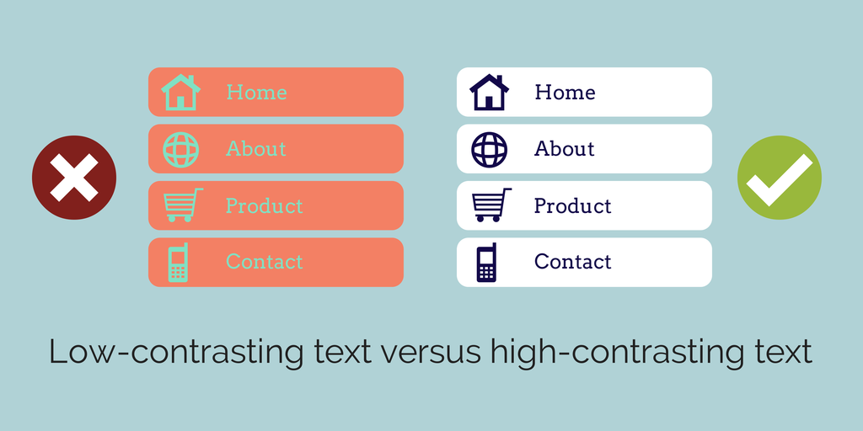
Text with Low Contrast

Slide 4
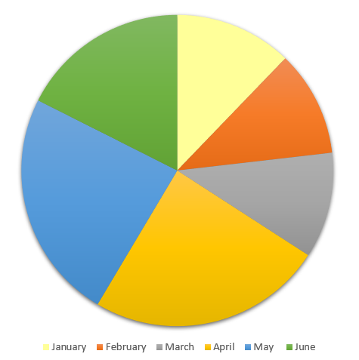
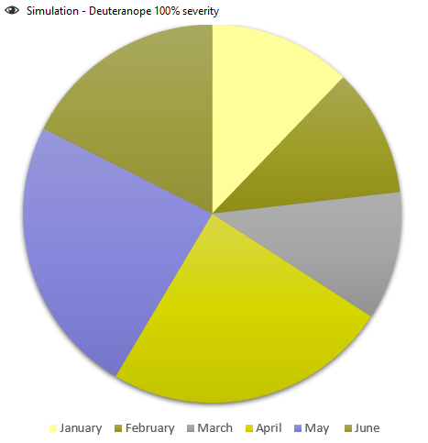
Inaccessible Pie Chart Only Using Color to Convey Information: Red/Green Deficiency

Slide 5
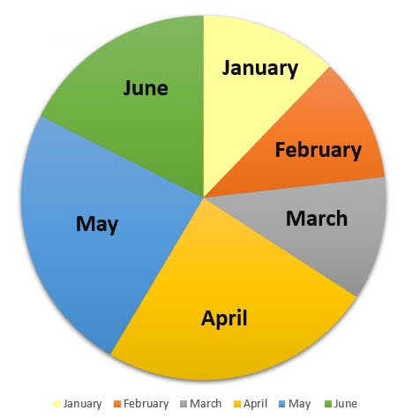
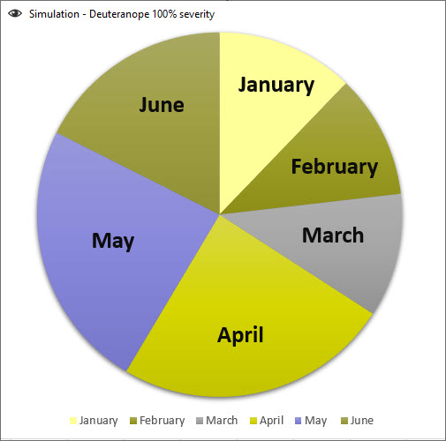
Accessible Pie Chart – Red/Green Deficiency

Slide 6
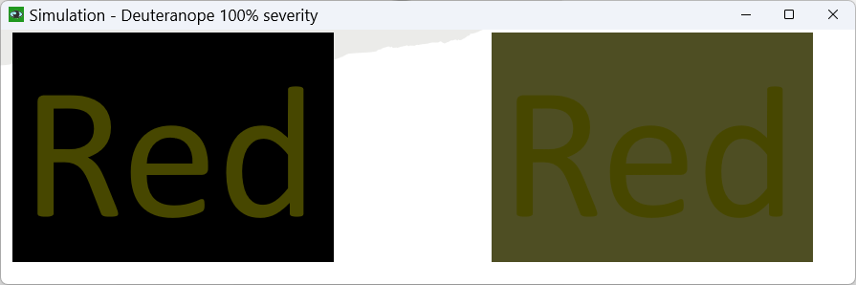
Examples: Red/Green Deficiency
Red
Red

Slide 7
Accessible Colors
Contrast Font 18 and higher 3:1
Contrast Font below 18 4.5:1
Do not use color alone to convey information
Avoid using Red and Black or Red and Green Combination
Text on Images
Use tools to check color contrast and simulate color blindness

Slide 8
Color Contrast
Note: there are tools to help you determine the contrast ratio. You don’t need to do the math to figure it out!
Font 18 or 14 bold and higher 3:1
Font below 18 or 14 bold 4.5:1
4.5:1 compensates for the loss in contrast sensitivity usually experienced by users with vision loss equivalent to approximately 20/40 vision.
20/40 calculates to approximately 4.5:1.
20/40 is commonly reported as typical visual acuity of elders at roughly age 80.

Slide 9

Contrast Algorithms
The algorithms compare the two colors' relative luminance — which essentially boils down to whether one color is lighter or brighter than the other.
Here, tomato (ff6347) and cornflowerblue (6495ed) are pretty much equally bright, which is why they're difficult to read together.
You don’t want to read this.
The ratio for these two colors is a 1.009:1 which is barely better than comparing a color to itself (1:1).

Slide 10
Text Passes Large Font but Fails Small Font
This is 18 pt font and it passes at 3.11
This is 18 pt font and it passes at 4.5:1
This is 16 pt font and it fails at 3.11
This is 16 pt font and it passes at 4.5:1
This is 18 pt font and it passes at 4.2:1
This is 18 pt font and it passes at 4.5:1
This is 16 pt font and it fails at 4.2:1
This is 16 pt font and it passes at 4.5:1

Slide 11
Color Blindness: Red-Green Color Deficiency
  The most common type of color vision deficiency makes it hard to tell the difference between red and green.
  There are 4 types of red-green color vision deficiency:
    Deuteranomaly is the most common type of red-green color vision deficiency. It makes certain shades of green look more red. This type is mild and doesn’t usually get in the way of normal activities.
    Protanomaly makes certain shades of red look more green and less bright. This type is mild and usually doesn’t get in the way of normal activities.
    Protanopia & deuteranopia both make someone unable to tell the difference between red & green at all.

Slide 12
Color Blindness: Blue-Yellow Color Deficiency
Blue-yellow color vision deficiency
  This less-common type of color vision deficiency makes it hard to tell the difference between several different color combinations.
  There are 2 types of blue-yellow color vision deficiency:
    Tritanomaly makes it hard to tell the difference between blue and green and between yellow and red.
    Tritanopia makes someone unable to tell the difference between blue and green, purple and red, and yellow and pink. It also makes colors look less bright.

Slide 13
Color Blindness: Complete Color Deficiency
  If you have complete color vision deficiency, you can’t see colors at all. This is also called monochromacy or achromatopsia, and it’s rare. Depending on the type, you may also have trouble seeing clearly, and you may be more sensitive to light.
Note: Color deficiencies (color blindness) are so diverse that prescribing effective general use color pairs (for contrast) based on quantitative data is not feasible.

Slide 14
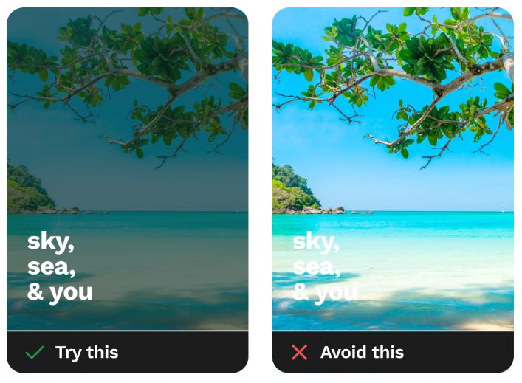
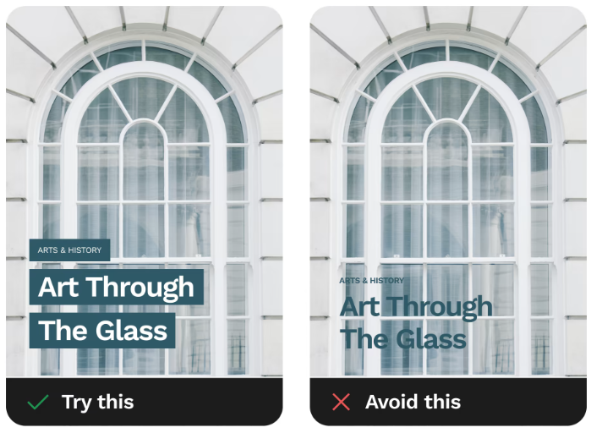
Text on Images: Dos and Don’ts
Source: https://www.smashingmagazine.com/2023/08/designing-accessible-text-over-images-part1/

Slide 15

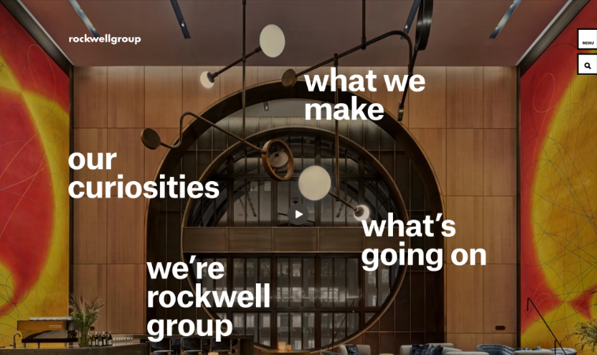
Text on Images that Work
Source: https://www.smashingmagazine.com/2023/08/designing-accessible-text-over-images-part1/

Slide 16
Tools to Check for Accessibility

Slide 17



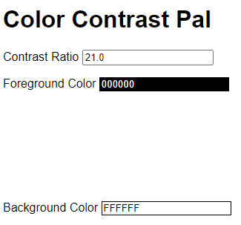

Tools for Color Contrast
Colour Contrast Analyser
WebAIM Website
Contrast Grid
Color Contrast Pal
Color Simulations

Slide 18
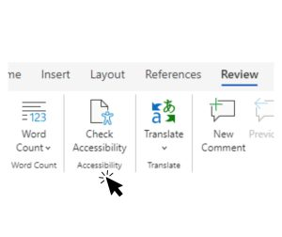
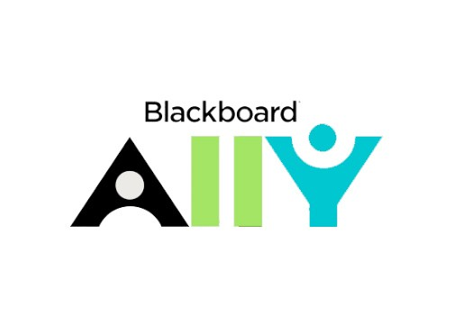
Tools to Check Word and PowerPoint
Microsoft Office Accessibility Tool
  Review > Check Accessibility
Blackboard Ally (if you have access to a Bb course or organization)

Slide 19
Tools to Check Websites
WAVE by WebAIM
  Browser Extension
  Displays code for webpage
Sa11y
  Bookmarklet
  Has Color Filter to simulate color blindness

Slide 20
Tool to Check PDFs
PDF Accessibility Checker: PAC 2021
  Free
  Windows only
Acrobat Pro
  Doesn’t check reading order or color contrast
  Only knows what it knows
  Has OCR
  Very technical

Slide 21
Basic Accessibility Checklist for Colors
  Contrast Font 18 and higher 3:1
  Contrast Font below 18 4.5:1
  Do not use color alone to convey information
  Avoid using Red and Black or Red and Green Combination
  Text on Images
  Use tools to check color contrast and simulate color blindness

