Slide 1

Digital Accessibility
Create an Inclusive and Accessible Experience
Accessible PDFs

Slide 2
Quick Statistics
(ages 21-64) Individuals with Disability vs. Individuals without Disability
2018 (2022)
Bachelor’s Degree or more without disability: 35.2% (38.6%)
Bachelor’s Degree or more with disability: 15.2 % (18.7%)
Employment without disability: 80.0% (63%)
Employment with disability: 37.8 % (30%)
Source: https://www.disabilitystatistics.org/StatusReports/2018-PDF/2018-StatusReport_US.pdf
Notes:
Erickson, W., Lee, C., & von Schrader, S. (2020). 2018 Disability Status Report: United States. Ithaca, NY: Cornell University Yang-Tan Institute on Employment and Disability(YTI).
https://www.disabilitystatistics.org/StatusReports/2018-PDF/2018-StatusReport_US.pdf
2022: Employment with disability 30%, Employment without disability 63%

Slide 3
Accessible PDFs
Add accessibility tools to Acrobat Pro
Document Title
  Doc Properties > Initial View > Show > Document Title
Accessible Fonts
Alt Text
Descriptive Hyperlinks
True Tables
Adequate Color Contrast
Tag Tree
  Headers
  Tables
  Lists
Reading Order

Slide 4
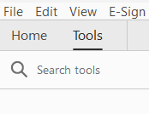
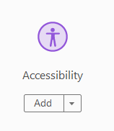
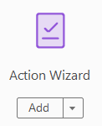
Setting Up Acrobat Pro
Tools: add Accessibility Tool and Action Wizard
Accessibility Tool
Auto tagging
Full check
Setting alternate text
Action Wizard
Make accessible
  Select this on an untagged PDF

Slide 5
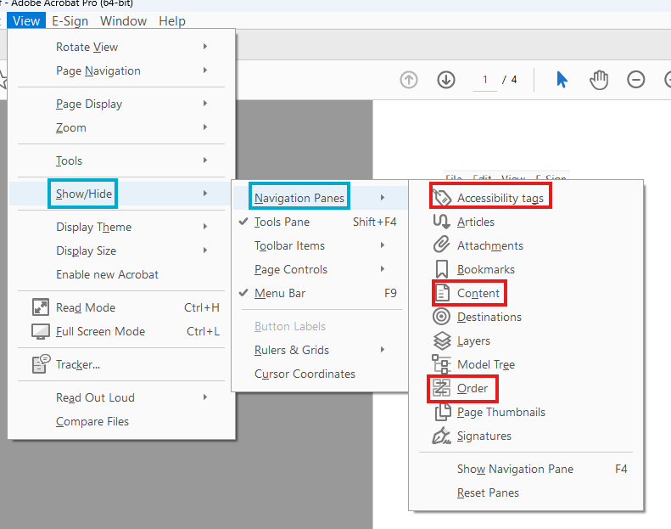
Adding Accessibility Icons
Content Panel
Order Panel
Tag Tree
To add these,
  View > Show Hide > Navigation Panes > Content
  To add these, View > Show Hide > Navigation Panes > Order (turn off Display like elements in a single block)
  To add these, View > Show Hide > Navigation Panes > Tags

Slide 6
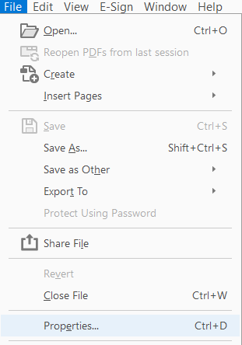
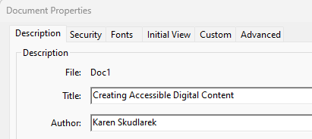
Add Meaningful Title & Author to Document

Slide 7
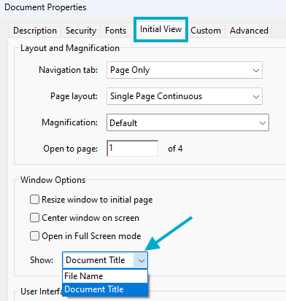
Set Initial View to Document Title

Slide 8
Tags
Tags are containers that store the metadata for the objects stored in a PDF.
They organize the information, so screen readers and other assistive technology can interpret the document and understand the relationship of the objects on a page.
Websites have over 100 types of tags, PDFs have about 40 types
Container tags organize information into groups: Document, Section, Part, Article. Ignored by screen readers, they are used by remediators of the file.
Document should always be the root tag
InDesign gives more Article tags while PowerPoint gives more Section tags

Slide 9
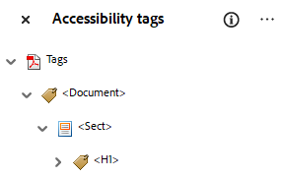
Commonly Used Tags
Start tag tree with Document (as root tag)
Headings (1-6) important for navigation with screen readers
Paragraph
Figure
Link
Nested Tags
  List (L, LI, Lbl, Lbody)
  Table (THead, TR, TH, TD, TBody)

Slide 10
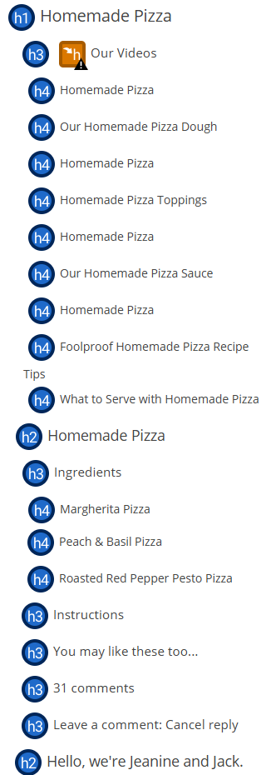
Headers:
Out of Order or Not Meaningful

Slide 11
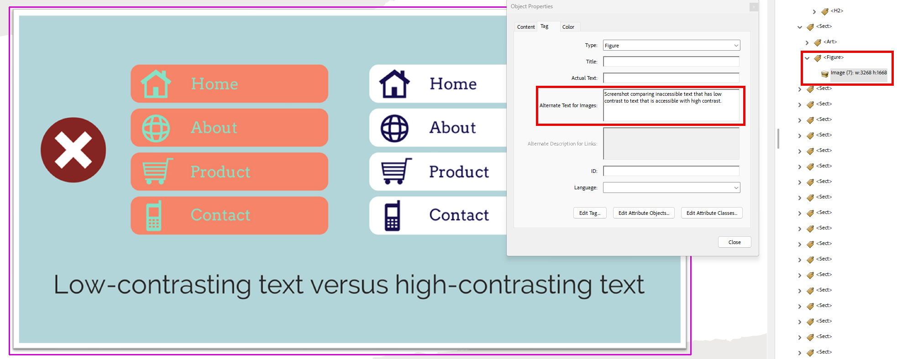
Figure Tags
Be sure to add Alt Text for Images

Slide 12
Alt Text
Do not start alt text with “picture of” or “graphic of”
Alt text is accurate (not file name)
Validate auto-generated alt text
Include enough information for end user
Exclude information found near the image (i.e. caption below image)
Include alt text of images with hyperlink
Alt text can vary for same image based on context
Graphs/Charts and maps are more complex
Ask content creator (person who wants to use the image) to write the alt text

Slide 13
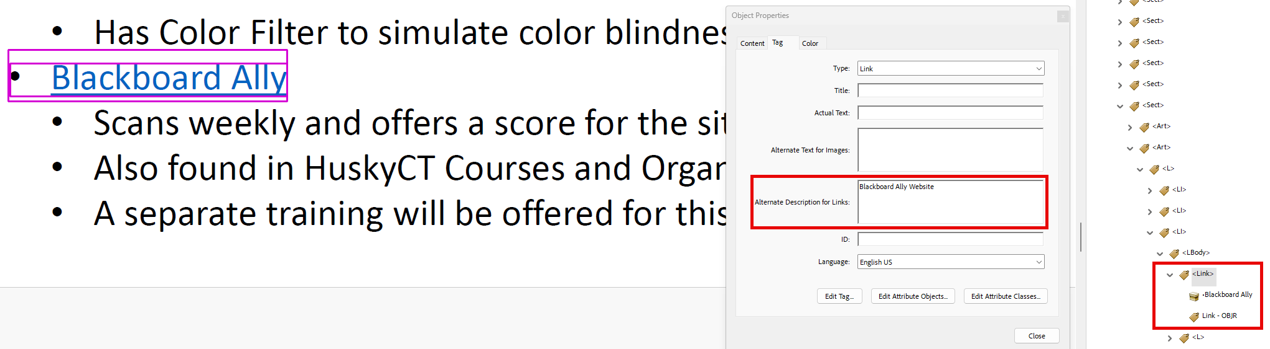
Link Tags
Be sure to add Alt Text for Links
Screen reader users navigate websites and documents tabbing link to link
Don’t underline text that isn’t a link
  Keyboard only users may think it’s a link and can’t access it by tabbing

Slide 14
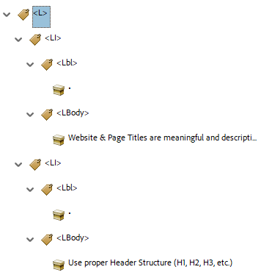
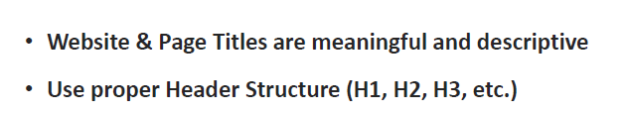
List Tags
  L (List)
    LI (List Item)
      Lbl (Label – bullet, number, etc.)
      Lbody (text of the list item)
    LI
      Lbl
      Lbody

Slide 15
True Tables
Use only data for tables
Designate top row as the header for each column and/or row
Table must start with a <Table> tag.
  Select the <Table> tag to expand a list of table rows (<TR>). You should have one <TR> tag for each row in the table including the header row(s).
  If the first row of the table is a header row, double click on each column (<TD>) to rename the element as a <TH>
  The first column of the table may also be used as a header. If so, expand each of the remaining Table Rows (<TR>). In each table row, change the first <TD> tag to a <TH> tag to mark it as a table header.

Slide 16
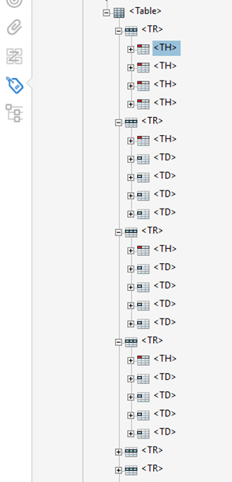
Tagged Table Example
The first TR tag is the first table row that contain headers so each item below it is TH (table header)
The remaining TR tags are the rows below the first column of headers and the first column is marked as a header TH.
  So, the first tag under the remaining TR is TH for the heading in the first column
 | Summer | Fall | Winter | Spring
Monday | 9:00-5:00 | 9:00-3:00 | 9:00-3:00 | 9:00-5:00
Tuesday | 8:00-6:00 | 9:00-6:00 | 9:00-3:00 | 8:00-6:00
Wednesday | 8:00-6:00 | 9:00-6:00 | 9:00-3:00 | 8:00-6:00
Thursday | 8:00-6:00 | 9:00-6:00 | 9:00-3:00 | 8:00-6:00
Friday | 9:00-3:00 | Closed | Closed | 9:00-3:00

Slide 17
Descriptive Hyperlinks
Screen reader users navigate websites tabbing link to link
Writing link text where it is going
  Do not use “click here,” “learn more,” “read more”
Example:
  IT Accessibility
Don’t underline text that isn’t a link
  Keyboard only users may think it’s a link and can’t access it by tabbing

Slide 18
Accessible Colors
Contrast Font 18 and higher 3:1
Contrast Font below 18 4.5:1
Do not use color alone to convey information
Avoid using Red and Black or Red and Green Combination
Text on Images
Use tools to check color contrast and simulate color blindness

Slide 19
Basic Accessibility Checklist for PDFs
  Add accessibility tools to Acrobat Pro
  Document Title
  Alt Text for images (verify auto generated alt text)
  Descriptive Hyperlinks
  True Tables
  Adequate color contrast
  Tag Tree
    Headers, Figures, Paragraphs, Links
    Tables
    Lists
  Reading Order

Slide 20
Tools to Test PDFs for Accessibility
PDF Accessibility Checker for Windows only
Blackboard Ally
  If you have access to a course or organization in HuskyCT (Blackboard) you can upload files to it.
  Let me know if you need access to a course and I can add you
  Ally will assign a score to the file(s).
  It scans PDF, DOCx, and PPTx

Slide 21
More UConn Resources
ITS Accessibility @ UConn
eCampus Accessible Syllabus Templates
Office of Institutional Equity: Accessibility @ UConn
Center for Students with Disabilities

