Slide 1

Digital Accessibility
Create an Inclusive and Accessible Experience
Accessible Word Documents

Slide 2
Quick Statistics
(ages 21-64) Individuals with Disability vs. Individuals without Disability
2018 (2022)
Bachelor’s Degree or more without disability: 35.2% (38.6%)
Bachelor’s Degree or more with disability: 15.2 % (18.7%)
Employment without disability: 80.0% (63%)
Employment with disability: 37.8 % (30%)
Source: https://www.disabilitystatistics.org/StatusReports/2018-PDF/2018-StatusReport_US.pdf
Notes:
Erickson, W., Lee, C., & von Schrader, S. (2020). 2018 Disability Status Report: United States. Ithaca, NY: Cornell University Yang-Tan Institute on Employment and Disability(YTI).
https://www.disabilitystatistics.org/StatusReports/2018-PDF/2018-StatusReport_US.pdf
2022: Employment with disability 30%, Employment without disability 63%

Slide 3
Accessible Word Documents
Document Title & Author
Headers and Styles
Alt Text
Descriptive Hyperlinks
True Tables
Header/Footer sections not read with screen reader (select different first page)
Adequate Color Contrast
Avoid Justified (Centered) Formatting
Accessibility Checkers
Creating PDFs from Copiers

Slide 4
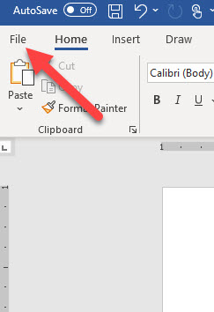
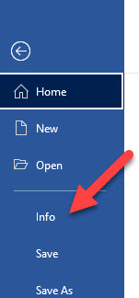
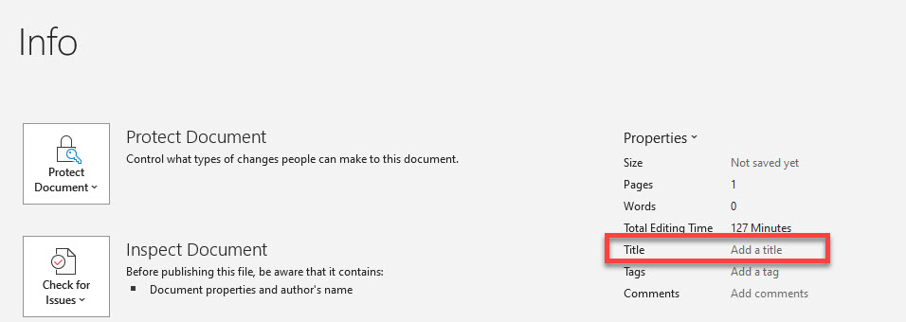

Add Meaningful Title & Author to Document
Example of a screen reader reading filename instead of a meaningful title.

Slide 5
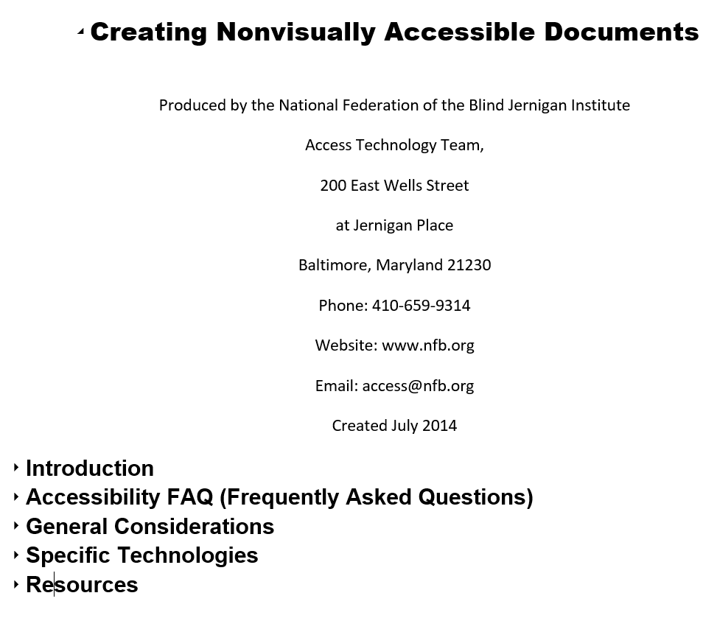
Headers and Styles
Tip: Turn on Navigation Pane in Word to see the structure. Click on View in the Ribbon and turn it on under Show section

Slide 6
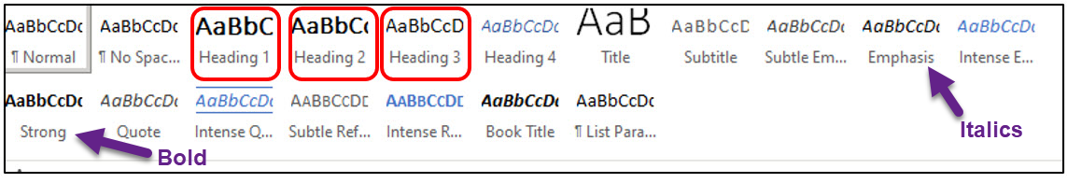
Headings: Word
Use the Styles found in the Home tab of the Ribbon
You can modify the heading format by right mouse clicking on the Heading in the Styles panel
Emphasis Style is for italics and Strong is for bold

Slide 7
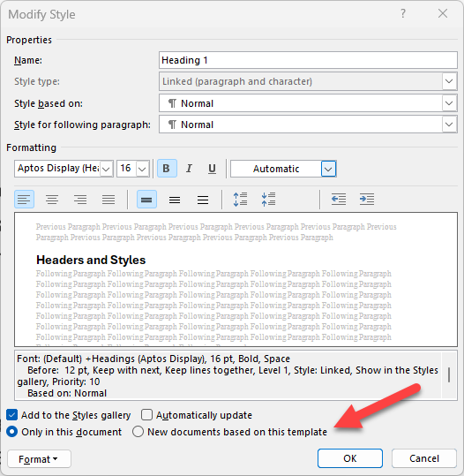
Blank Template for Word: Normal.dotm
When you open Word and use the Blank template, it uses the Normal.dotm file.
If you make changes to any of the Styles in the Blank template and select New documents base on this template, it will save the changes to the Normal.dotm.
You can create custom templates if you use different Heading Styles for various documents.

Slide 8
Alt Text
Do not start alt text with “picture of” or “graphic of”
Alt text is accurate (not file name)
Validate auto-generated alt text
Include enough information for end user
Exclude information found near the image (i.e. caption below image)
Include alt text of images with hyperlink
Alt text can vary for same image based on context
Graphs/Charts and maps are more complex
Ask content creator (person who wants to use the image) to write the alt text

Slide 9
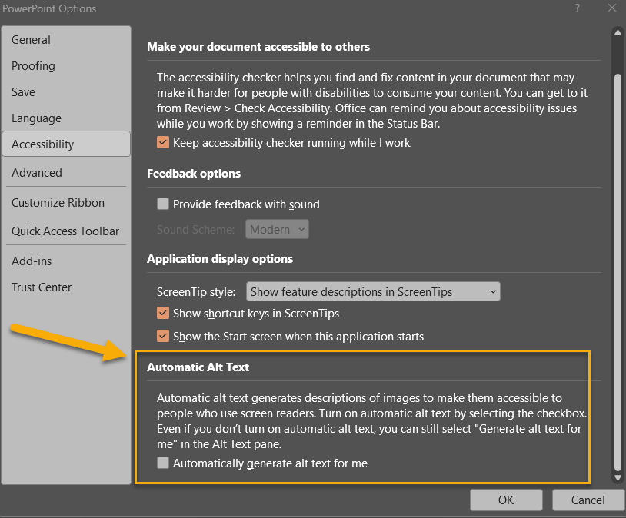
Automatic Alt Text Setting in Microsoft
You can turn on/off the Automatic Alt Text Setting found in File > Options > Accessibility

Slide 10
Descriptive Hyperlinks
Screen reader users navigate websites tabbing link to link
Writing link text where it is going
  Do not use “click here,” “learn more,” “read more”
Example:
  IT Accessibility
Don’t underline text that isn’t a link
  Keyboard only users may think it’s a link and can’t access it by tabbing

Slide 11
True Tables
Use only data for tables
Designate top row as the header for each column
Be sure to turn on Repeat Header Row
Add Alt Text to the Table
Cannot create accessible table if using split cells, merged cells, or nested tables in Word. Must use Acrobat Pro.
Tab through each cell to check for navigation (left to right and down)

Slide 12
True Tables Examples
Inaccessible Table
Karen | Jonathan
(860) 486-0506 | (860) 486-1234
karen.skudlarek@uconn.edu | jonathan.husky@uconn.edu
Accessible Table
Name | Phone Number | Email
Karen | (860) 486-0506 | karen.skudlarek@uconn.edu
Jonathan | (860) 486-1234 | jonathan.husky@uconn.edu

Slide 13
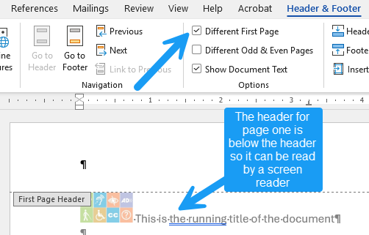
Headers and Footers
Screen readers do not read content in headers and footers (i.e. company logo, running title, or page numbers)
If using a header with content that repeats on every page, turn on “different first page” and put the content from the header in the body of the document for page one only. Then it’s read to the end user but ignored for the rest of the document.
Page numbers do not need to be read to someone with a screen reader if the document is formatted properly with headings (H1, H2, H3), etc., page numbers can remain in the footer.

Slide 14
Accessible Colors
Contrast Font 18 and higher 3:1
Contrast Font below 18 4.5:1
Do not use color alone to convey information
Avoid using Red and Black or Red and Green Combination
Text on Images
Use tools to check color contrast and simulate color blindness

Slide 15
Avoid Justified (Centered) Formatting
Although it allows the text to appear as a single block with perfect margins, it also creates inconsistent spacing, which can force the reader’s eyes to “jump" when reading.
This becomes a serious issue when using assistive technologies (AT). Many people with vision disabilities use screen magnifiers or enlarge web content by “zooming in" on the page. If text is justified, these users may see large, empty spaces between (or within) words — or the words may run together in a confusing mess of characters.
Fully justified text can create uneven spaces between words and letters, making it difficult for those with dyslexia.

Slide 16
Accessibility Checkers
Microsoft Office
  Review > Check Accessibility
  Turn on Navigation Pane
HuskyCT/Blackboard Ally
  For courses and websites
PDF/UA PDF Checker
  It’s more technical than using Office or Ally Accessibility checkers but can give you a sense of what may need to be remediated for the PDF.

Slide 17
Scanning to PDF from Copiers
Be sure to OCR the document before scanning to PDF.
Selecting OCR (Optical Character Recognition) for PDFs created at UConn printers converts typed or printed text into machine-encode text to be read by a screen reader and searched.

Slide 18
More UConn Resources
ITS Accessibility @ UConn
eCampus Accessible Syllabus Templates
Office of Institutional Equity: Accessibility @ UConn
Center for Students with Disabilities

Slide 19
Basic Accessibility Checklist for Word Documents
  Document Title & Author
  Accessible Font (Arial, Calibri, Verdana)
  Turn on Navigation Pane)
  Alt Text for images and Tables
  Headers and other Styles
  Descriptive Hyperlinks
  Using True Tables with Headers (repeat header row)
  Header/Footer sections not read with screen reader (select different first page)
  Adequate color contrast
  Check accessibility with Office and/or Blackboard Ally

