Slide 1

Accessible Colors
ITS ACCESSIBILITY
Create Inclusive & Accessible Experiences
December 2025

Slide 2

Barriers in Color Perception
Visual Examples
Notes:
We’ll start with barriers that can exist as they relate to colors.

Slide 3
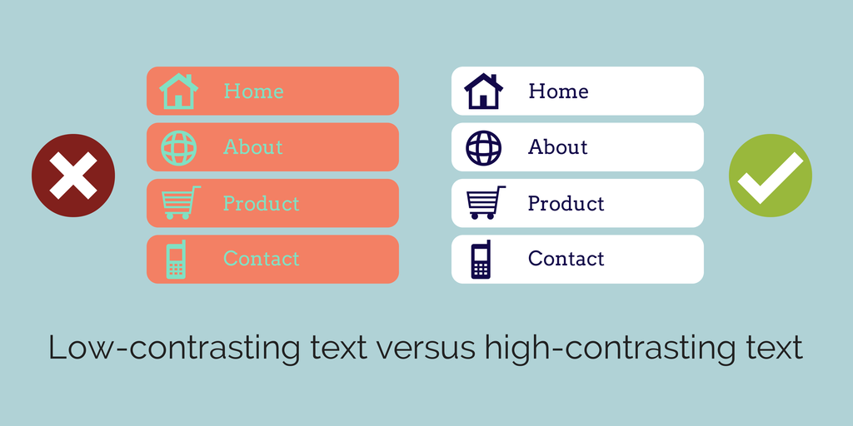
Low versus High Contrast
Low contrast colors will blend together, while high contrast ones will be distinct.
ITS Accessibility – Create Inclusive & Accessible Experiences
Notes:
First, there needs to be enough color contrast between the foreground and background colorsThe example on the left shows low contrast, while the example on the right demonstrates high contrast.

Slide 4
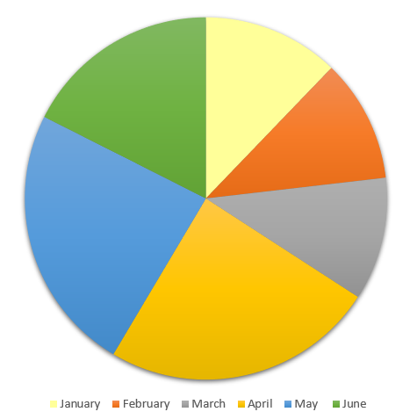
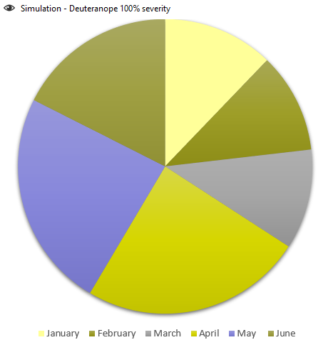
Using Only Color: Red/Green Deficiency
Someone with red/green color blindness will struggle to differentiate between red and green.
ITS Accessibility – Create Inclusive & Accessible Experiences
Notes:
A second example of a barrier is only using color to convey information. In this example, if someone is color blind they may not be able to differentiate between February and June.

Slide 5
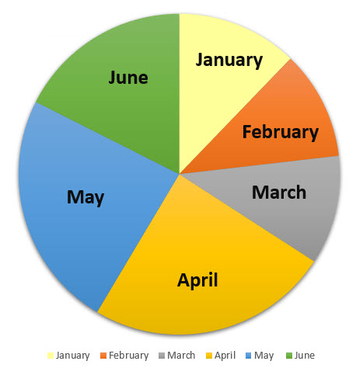
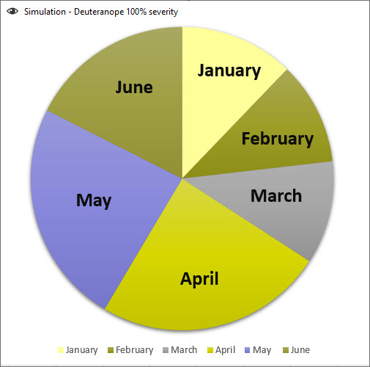
Adding Labels: Red/Green Deficiency
Adding labels boosts readability for people with color blindness.
ITS Accessibility – Create Inclusive & Accessible Experiences
Notes:
If we add a label to each wedge, the end user doesn’t rely on color alone to convey the information.

Slide 6
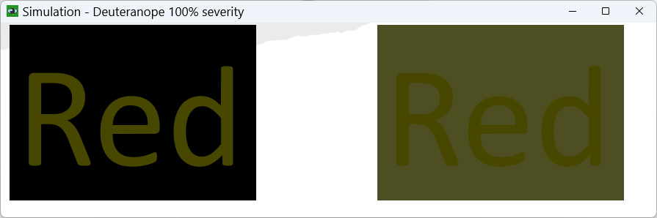
Red/Green Deficiency
Red
Red
People with red/green color blindness find distinguishing red and green, as well as red and black particularly difficult.
The examples above are the actual colors, while the ones in the simulator to the left show color blind reality.
ITS Accessibility – Create Inclusive & Accessible Experiences
Notes:
Red can be a challenging color because some people who have a certain form of color blindness may not be able to differentiate between red and black or red and green. So, be careful when using red. The images at the top are the actual colors, the images at the bottom are the same text but shown using a simulator that simulates red/green color blindness.

Slide 7
Improving Color Accessibility
A Brief Overview
Notes:
In the next slides we’ll review ways you can improve color accessibility.

Slide 8
Color Guidelines
Color Contrast
Color Blindness
3:1 ratio for 18pt font or higher.
4.5:1 ratio for less than 18pt font.
Distinguish text from images.
Use contrast checker tools:
  Color contrast ratio
  Color blindness simulator
Add labels or icons for information in addition to color.
Avoid red/black and red/green color combinations.
ITS Accessibility – Create Inclusive & Accessible Experiences
Notes:
So what is enough color contrast? The Web Content Accessibility Guidelines or WCAG, require that the color contrast between the foreground color and the background color is 4.5 to 1. If the font is 18 point font or higher, the threshold can be lower at three to one. The color contrast between white and black is the highest at 21 to 1. I recommend always using the 4.5 to 1 ratio no matter the size of the font. There are many tools available to help make these calculations.

Slide 9
Color & Typography
Ensure 3:1 ratio for 18pt font size or higher and 14pt bold text.
Aim for 4.5:1 ratio in smaller typography.
Ratio is based on calculation for vision.
  20/40 calculates to approximately 4.5:1.
  20/40 is commonly reported as typical visual acuity of elders at roughly age 80.
Use tools that calculate contrast ratio.
ITS Accessibility – Create Inclusive & Accessible Experiences

Slide 10

Contrast Algorithms
You don’t want to read this.
Algorithms compare the luminance of two colors to each other to calculate their distinctness.
Example on right:
Tomato (ff6347) & cornflower blue (6495ed).
Both are equally bright, so they lead to reading difficulty.
Contrast = 1.009:1
This is essentially comparing a color to itself (1:1).
ITS Accessibility – Create Inclusive & Accessible Experiences
Notes:
The algorithms compare the two colors’ relative luminance. Black on white is a 21 to 1 ratio. The same color on itself is a 1 to 1 ratio. This is an example of two colors with similar brightness. This is what it looks like used together. And when the tools calculate the color contrast is it almost a 1 to 1 ratio, the same color on itself. This is why it’s important you use the tools to help make these calculations.

Slide 11


Passing Large Font; Failing Small
This is 18pt font and it passes at 3.11
This is 18pt font and it passes at 4.5:1
This is 16pt font and it fails at 3.11
This is 16pt font and it passes at 4.5:1
This is 18pt font and it passes at 4.2:1
This is 18pt font and it passes at 4.5:1
This is 16pt font and it fails at 4.2:1
This is 16pt font and it passes at 4.5:1
ITS Accessibility – Create Inclusive & Accessible Experiences
Notes:
On the left are examples of where an 18 pt font will pass with a 3 to 1 ratio, but a 16pt font will not. Making small changes in the colors used and shown on the right, the color contrast is acceptable no matter the size. Again, this is why it’s important you use the tools available to ensure enough color contrast.

Slide 12
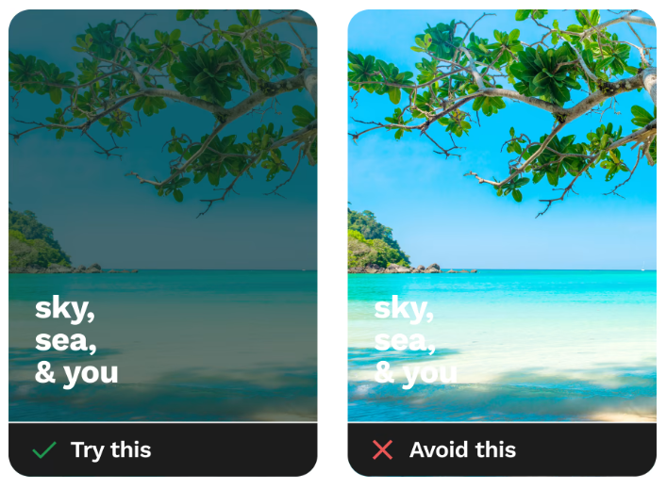
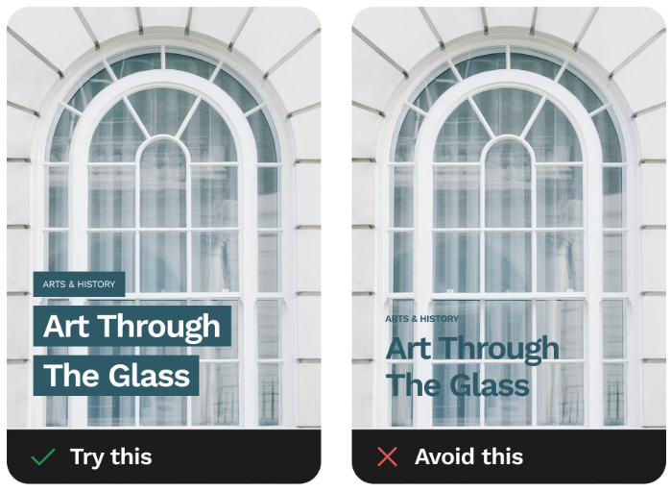
Text on Images: Do’s and Don’t
Source: https://www.smashingmagazine.com/2023/08/designing-accessible-text-over-images-part1/
ITS Accessibility – Create Inclusive & Accessible Experiences
Notes:
Another challenge occur when there is text on images because the images have varying colors and brightness throughout them. It’s best to either mute the background image as shown on the left, or as shown on the right, add a solid block behind the text to ensure there is enough color contrast.

Slide 13

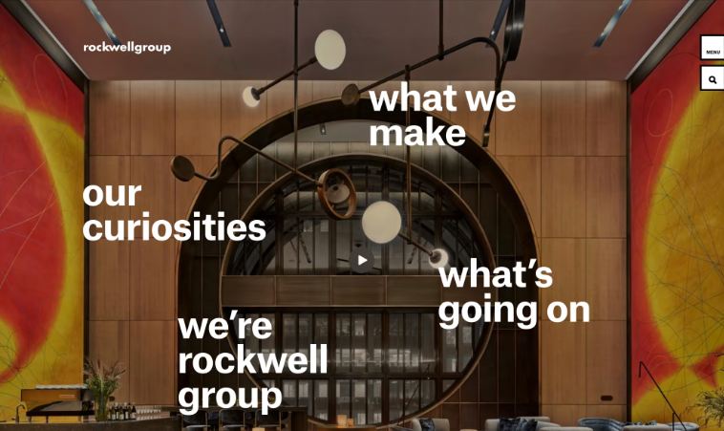
Text on Images: Examples
Source: https://www.smashingmagazine.com/2023/08/designing-accessible-text-over-images-part1/
ITS Accessibility – Create Inclusive & Accessible Experiences
Notes:
These are two more examples of text on images that work.

Slide 14
Contrast Checker Tools
Online Resources
Notes:
There are a variety of tools to help ensure there is enough color contrast.

Slide 15

Tools for Color Contrast
WebAIM Website
Contrast Grid
Colour Contrast Analyser
Color Contrast Pal
Coolors
Browser Extensions such as Web Disability Simulator
ITS Accessibility – Create Inclusive & Accessible Experiences
Notes:
The tool I like to use the most is WebAIM. If you have the hex code for the colors, you can enter it to get the contrast ratio. If not, you can use the eyedropper tool to select the color. Then when you have the foreground and background colors, if there’s not enough color contrast, you can move the slider to select a color that works.
The Contrast grid is great tool that can be used in a marketing campaign or an annual report where a specific color scheme is used throughout. You can enter the hex codes for the colors to get a table with the color combinations that meet the 4.5 to 1 ratio requirement. The regulation requires that we meet level AA. Triple A is more restrictive, so you would select both AA and triple A. Colour Contrast Analyzer and Color Contrast Pals have similar features and can also be helpful. Finally, there are a variety of browser extensions you can use to simulate the experience of someone with varying disabilities such as color blindness or dyslexia.

Slide 16
Accessibility Checkers
Word & PowerPoint
Websites
Microsoft Office Accessibility Tool
  Review > Check Accessibility
Blackboard Ally (HuskyCT)
  For access to a HuskyCT course, email karen.skudlarek@uconn.edu.
Siteimprove
  For access, contact itaccessibility@uconn.edu.
WAVE by WebAIM
  Free browser extension.
  Displays code for webpage.
ITS Accessibility – Create Inclusive & Accessible Experiences
Notes:
You can also use the Accessibility Checker in Word and PowerPoint. It will check for color contrast for the text in the document. It will not check color contrast for text over an image. You will need to use the tools for that. If you have access to a course or organization in HuskyCT, you can upload Word, PowerPoint and PDFs to it so you can get an accessibility score. It will also check for color contrast. If you don’t have a course or organization, and want access, please email me at karen.Skudlarek@uconn.edu and I will add you to a course.
We also have Siteimprove that checks websites for accessibility. Please email ITAccessibility@uconn.edu if you would like access to Siteimprove. You can also use the WAVE extension in any browser to check individual pages for accessibility.

Slide 17
PDF Accessibility Checkers
PDF Accessibility Checker 2024 (free) for Windows only
Blackboard Ally (HuskyCT)
  Can upload files into HuskyCT with course or organization access.
  Email karen.skudlarek@uconn.edu for course access, if necessary.
  Ally will assign an accessibility score to any uploaded file.
  Scans PDF, DOCx, and PPTx.
Acrobat Pro
  Doesn’t check reading order or color contrast.
  Has an Optical Character Recognition (OCR) option to extract text.
  Very technical.
ITS Accessibility – Create Inclusive & Accessible Experiences
Notes:
There are tools that check only PDFs. One is PDF Accessibility checker 2024 for Windows only. It checks all of the WCAG requirements. Acrobat Pro also has an accessibility checker, but it does not check for color contrast.

Slide 18
Accessible Colors Checklist
18pt font or higher has a 3:1 contrast ratio.
Font size below 18pt has 4.5:1 contrast ratio.
Labels and icons are used with color to convey information.
Red/black and red/green combinations are used cautiously.
Text color is distinguishable from images colors.
Tools were used to check color contrast and simulate color blindness.
ITS Accessibility – Create Inclusive & Accessible Experiences
Notes:
You can use this checklist to make sure that you’re meeting the requirements for color contrast and other accessibility barriers related to colors.

Slide 19

Thank You!
ACCESSIBLE COLORS
UConn ITS Accessibility
accessibility.its.uconn.edu
Notes:
Thank you for your time and please, check out the other workshops related to accessibility.

Slide 20
University of Connecticut Wordmark

