Slide 1

Accessible Images
ITS ACCESSIBILITY
Create Inclusive & Accessible Experiences
December 2025

Slide 2
Alternative Text
Provides a brief, informative description of image-based elements.
Will populate on a webpage if an image doesn’t load.
Alt text can be near the image when text equivalent cannot be presented succinctly, or it can be presented on a separate page.
Alt text is housed in the alt (alt=) attribute of an image in HTML content.
Mark images as decorative if they don’t convey information or evoke an emotion so someone who can’t see the image can ignore it just like someone who can see.
HTML for decorative images is alt="" (no space between quotes).
ITS Accessibility – Create Inclusive & Accessible Experiences
Notes:
To ensure that everyone can access images, it’s important to include alternative text. It provides a brief description of an image so if someone cannot see it, they can access the information. It will populate on a webpage if an image doesn’t load. If it can’t be presented succinctly because it requires a lot of detail, the alt text can be near the image or presented on a separate page. When using html code for alt text, use the alt= attribute. Images can be purely decorative if they don’t convey information or evoke an emotion. A sighted person will typically ignore decorative images, therefore someone who can’t see it, should also be able to ignore it. The screen reader used by these individuals will ignore the image and person won’t know it exists, essentially creating equal access. In Microsoft, there is a check box that can be checked if it is decorative. When using HTML it is written as alt= with two quotes and no space between the quotes.

Slide 3
Who Benefits from Alt Text?
Screen Reader Users
Cognitive Disabilities Persons
Screen readers may read out the file names for images that lack alt text.
Some people may find it challenging to parse large amounts of images.
Limited Internet Bandwidth
Search Engine Optimization
Turned off images for reduced loading time can still convey info from alt text.
Helps quickly search for an image or content with alt text.
ITS Accessibility – Create Inclusive & Accessible Experiences
Notes:
Who benefits from alt text? People who rely on screen readers to access the information found in an image. When alt text isn’t available and the image isn’t decorative, the end user will only know there is an image and may hear the file name, but will get nothing else. People with cognitive disabilities also benefit from alt text because it they may find it challenging to parse large amounts of images. Anyone with limited bandwidth may rely on alt text because when an bandwidth is low, the images will not load, but the alt text will. And finally, search engine optimization can be improved by the content in the alt text, but remember to only use it to convey the information that is in the image. Don’t use it just to improve SEO by using keywords only.

Slide 4

Barriers in Alt Text
Visual Examples

Slide 5
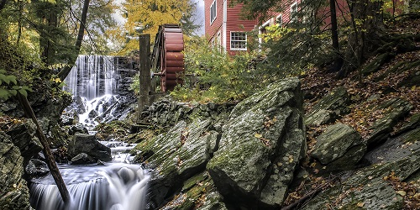
Inaccurate Alt Text
Alt Text: 20282.jpg (name of the file)
ITS Accessibility – Create Inclusive & Accessible Experiences

Slide 6
Not Reviewing Auto-Generated Alt Text
Alt Text: A water mill and a red building.
ITS Accessibility – Create Inclusive & Accessible Experiences

Slide 7
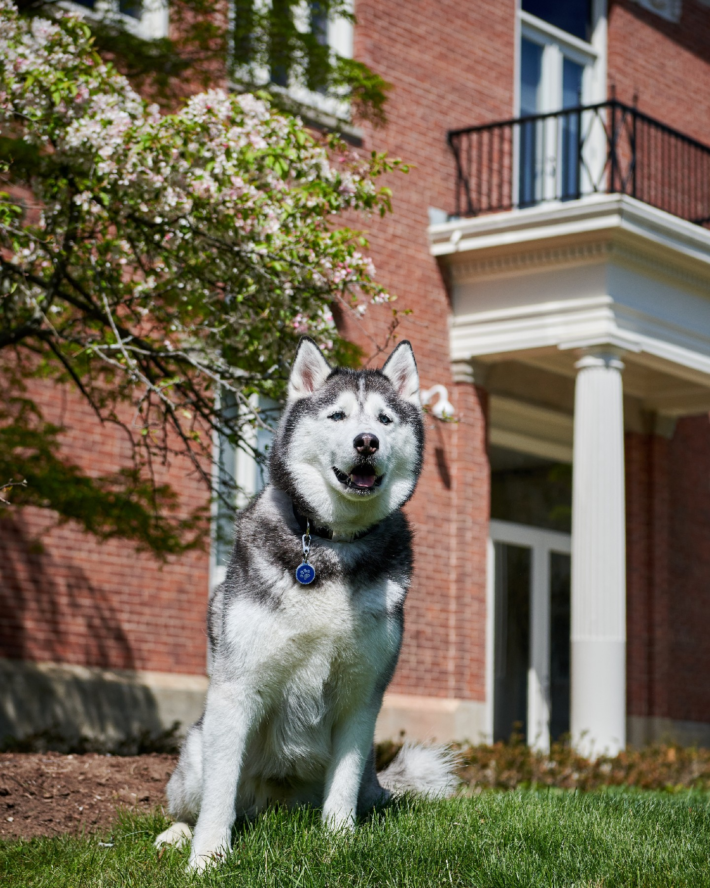
Marking Images as Decorative
Does the image evoke an emotion?
If yes, describe the emotion within the alt text.
If no, mark the image as decorative.
ITS Accessibility – Create Inclusive & Accessible Experiences

Slide 8
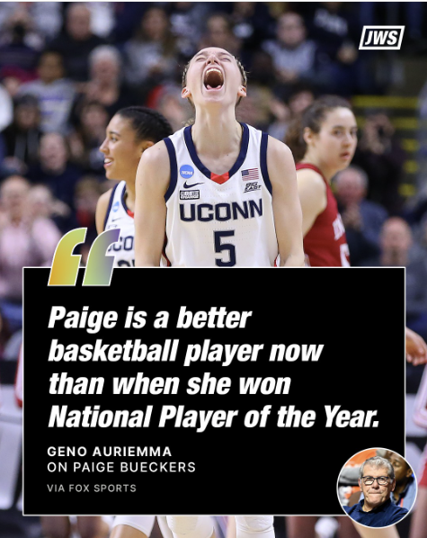
Text on Images
Does the image contain text?
If yes, include it verbatim within the alt text.
If no, don’t add to the alt text.
ITS Accessibility – Create Inclusive & Accessible Experiences

Slide 9
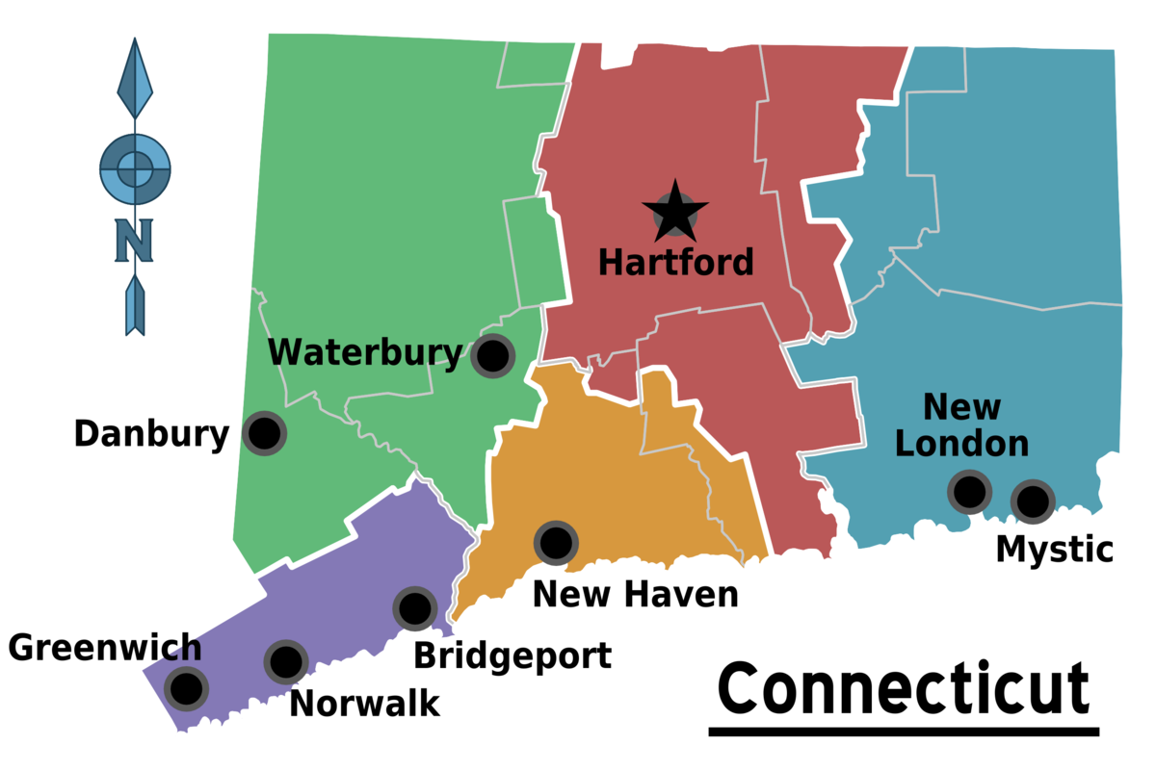
Not Providing Enough Information
Alt Text: Map of Connecticut.
ITS Accessibility – Create Inclusive & Accessible Experiences
Notes:
Not all alt text is good alt text. It’s important to include enough detail to the end user.

Slide 10
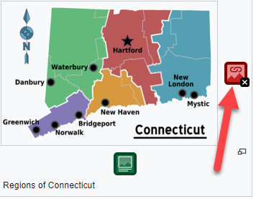
Linked Imaged without Alt Text
A linked image without alternative text results in an empty link.
ITS Accessibility – Create Inclusive & Accessible Experiences
Notes:
Finally, there are some images that are used as links. A linked image without alt text results in an empty link. Be sure to include alt text for linked images.

Slide 11
Improving Image Accessibility
A Brief Overview

Slide 12
Alt Text for Images
Do not start alt text with “picture of” or “graphic of”.
Alt text describes the image; not file name.
Auto-generated alt text needs to be reviewed.
Be brief yet informative, but exclude information found near the image.
Include alt text of images with hyperlink.
Alt text can vary for same image based on context.
Graphs, charts, and maps may be more complex.
Ask content creator (image user) to write the alt text.
ITS Accessibility – Create Inclusive & Accessible Experiences
Notes:
Some of this will be a review. First, don’t start alt text with picture of or image of because a screen reader will already include this. But if it’s a screenshot, drawing, cartoon, or any other type of special image, include this in the beginning. Ensure you describe the image and don’t use the file name and review any auto-generated alt text.
When writing alt text, be brief but informative (concise and precise). And exclude information found near the image such as a caption below it.
Include alt text for a linked image. Alt text may be more complex when there is a chart or graph. Finally, it’s best to ask the content expert – the person who wants to share the image – to write the alt text.

Slide 13
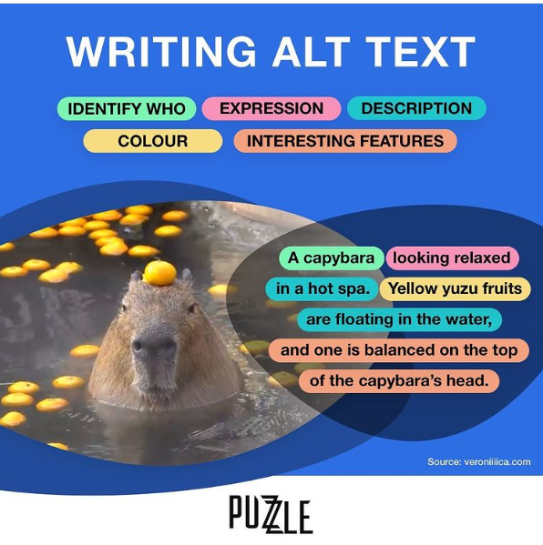
What’s in an Alt Text?
Type of image (bar graph, drawing, cartoon, screenshot, etc.).
Text – All text should be written in alt text.
Who is in the image and where it’s located.
Color(s) – Use shade names such as cobalt blue for image details.
Expression and emotions depicted in the image.
Item locations and descriptions.
Interesting details users may want to know.
Link to data or transcript.
ITS Accessibility – Create Inclusive & Accessible Experiences
Notes:
The Perkins School for the Blind shared questions you should ask when writing alt text. First, as I mentioned earlier, if it’s a special type of image, such as a screenshot, include it. Then ask, is there text in the image? If so, it should be verbatim. Who is in the image, what colors are there and are they significant? What expressions or emotions are evoked or depicted? Finally, where are items located and is there anything important about them. If there is a lot of detail, there can be a link to the data or transcript.
This is an example they used. Who is in the image, a capybara, what is the expression, looking relaxed, where are they, in a hot spa, what colors are shown, what items are there and where are they located, yellow yuzu fruits floating in the water, and what interesting details are there, the yuzu fruit is balanced on the top of the capybara’s head. So the alt text would be, A capybara looking relaxed in a hot spa. Yellow yuzu fruits are floating in the water, and one is balanced on the top of the capybara’s head.

Slide 14
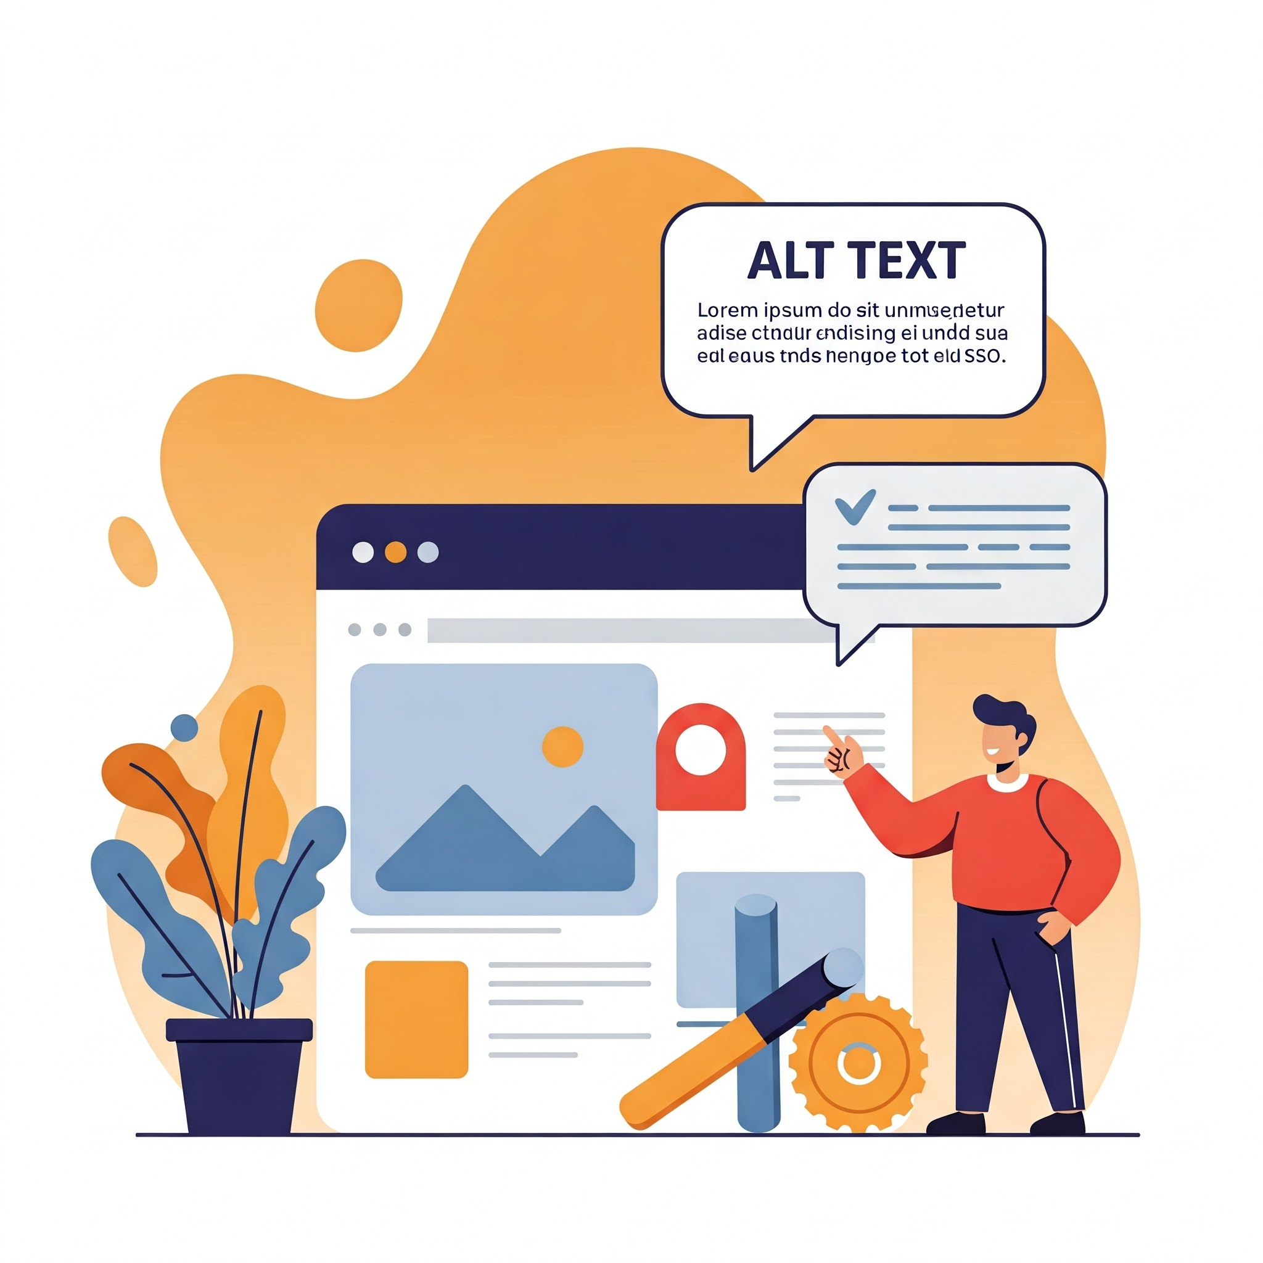
Tips for Writing Effective Alt Text
Be accurate and equivalent.
  Represent content and function.
Describe content concisely (short)
Avoid redundant information.
  Don’t repeat text near image.
Include text verbatim as on images.
Exclude “Graphic of” or “Image of”.
  Screen readers already state type.
ITS Accessibility – Create Inclusive & Accessible Experiences

Slide 15
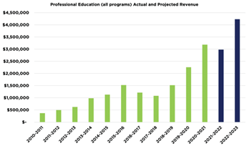
Graphs and Charts
Questions to Consider
What is it and what is it showing?
  Bar graph showing actual and projected revenue for professional education.
What are the axis values?
  Millions of dollars in revenue from 2010 through 2023.
What is the trend or main takeaway?
  Revenue has been steadily increasing each year from about 475,000 dollars in 2010 with a projected revenue of about 4.25 million dollars in 2023.
ITS Accessibility – Create Inclusive & Accessible Experiences
Notes:
Graphs are a special type of image because they can contain a lot of detail. You’re looking for 2-3 sentences that include the following questions:
What is it and what is it showing? What are the values, such as axis values, and most importantly, what is the trend or main takeaway. The main takeaway should be written by the content export or the person who wants to share the image. In this example it could be Bar graph showing actual and projected revenue for professional education. The graph shows millions of dollars in revenue from 2010 through 2023. Revenue has been steadily increasing each year from about 475,000 dollars in 2010 with a projected revenue of about 4.25 million dollars in 2023.

Slide 16
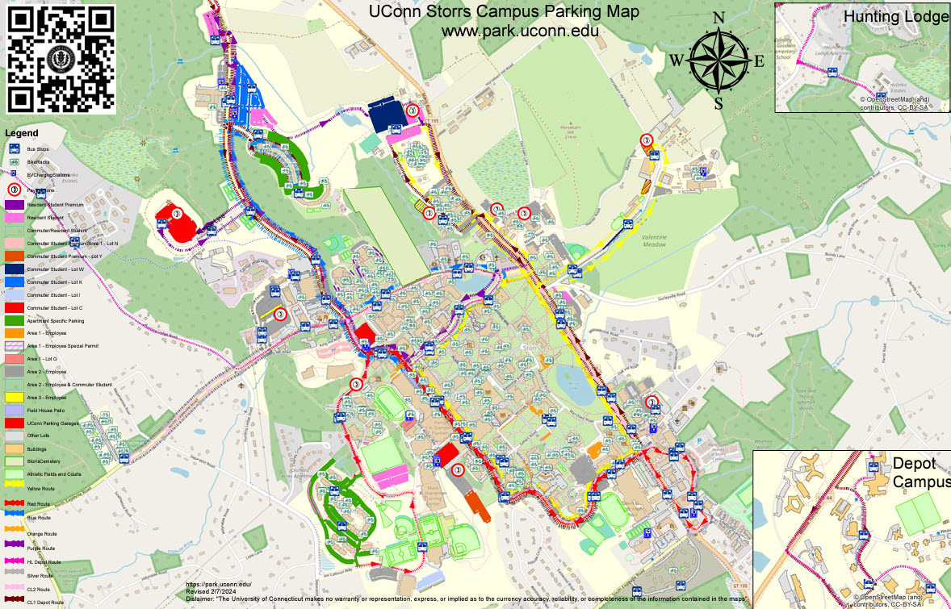
Maps
Possible Alt Text: Parking Map of UConn Storrs, CT for visitors, students, and employees, with bus routes highlighted. If you need more information, please email parkingservices@uconn.edu or call (860) 486-4930 Monday through Friday 8:00 AM to 4:00 PM.
ITS Accessibility – Create Inclusive & Accessible Experiences
Notes:
Maps are another type of special image because there can be so much data, that it all can’t be depicted in the alt text. In this case, it’s important to include what it is, who is it for, and any other important details. Finally include contact information such as an email or phone number with the days and times someone is available to answer questions or offer more detail.

Slide 17
Social Media Policies
X (Twitter) supports alt text up to 1,000 characters.
  Cannot be added or edited once posted without X Premium.
  How to add alt text when posting on X.
Instagram and Facebook support unlimited characters for alt text.
  Can be added or edited after posting.
  Facebook includes Automatic Alt Text (AAT) technology for alt text assistance.
  Instagram: edited after a picture is posted.
  Facebook: edit the alt text for images.
LinkedIn supports alt text up to 1,000 characters.
Source: Perkins.org
ITS Accessibility – Create Inclusive & Accessible Experiences
Notes:
Social Media relies heavily on images. The following platforms have some limitation.
X (Twitter) supports alt text up to 1,000 characters, though alt text cannot be added or edited after an image or gif is posted, unless you have a X Premium. How to add alt text when posting on X.
Instagram has no limit on the number of characters, and alt text can be added or edited after a picture is posted.
Facebook has no limit on the number of characters, and alt text can be added or edited after a picture is posted.
Facebook’s Automatic Alt Text (AAT) technology uses computer vision and artificial intelligence to automatically create a description of the image. The automatic alt text may not always be complete, but you can edit the alt text for images you upload or post.
LinkedIn: supports up to 1,000 characters

Slide 18
Accessible Images Checklist
Alt text doesn’t start with “picture of” or “graphic of”.
Alt text is accurate (not file name) to image.
Auto-generated alt text is validated.
Enough information has been included for the end user.
Text in image is included verbatim.
Information found near the image (i.e. caption below image) is excluded.
Images with hyperlinks have alt text.
Alt text can vary for same image based on context.
Ask content creator/expert to write the alt text.
ITS Accessibility – Create Inclusive & Accessible Experiences
Notes:
You can use this checklist to make sure that you’re meeting the requirements for ensuring that images are accessible

Slide 19

Thank You!
ACCESSIBLE IMAGES
UConn ITS Accessibility
accessibility.its.uconn.edu
Notes:
Thank you for your time and check out the other workshops related to accessibility.

Slide 20
University of Connecticut Wordmark

