Slide 1
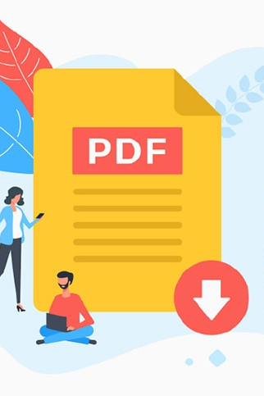
Accessible PDFs
ITS ACCESSIBILITY
Create Inclusive & Accessible Experiences
December 2025

Slide 2
Making PDFs Accessible
Add accessibility tools to Acrobat Pro.
Include a document title.
Use accessible fonts and ensure sufficient color contrast.
Images should have alt text unless marked as decorative.
Describe hyperlinks appropriately with text display.
Tables must be easily navigable using correct tags.
Tag Tree should include headers, tables, lists, etc.
Reading Order needs to be logical for screen readers and tabbing.
ITS Accessibility – Create Inclusive & Accessible Experiences

Slide 3
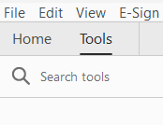
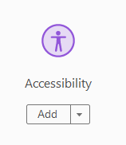
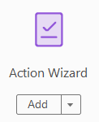
Setting Up Acrobat Pro
Accessibility Tool
Auto tagging
Full check
Setting alternate text
Action Wizard Tool
Make accessible
Select this on an untagged PDF
ITS Accessibility – Create Inclusive & Accessible Experiences

Slide 4
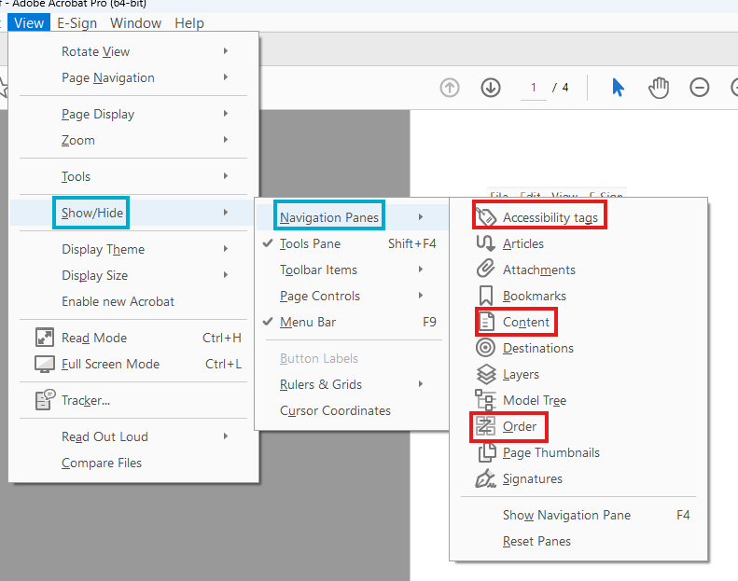
Adding Accessibility Icons
Content Panel
View > Show Hide > Navigation Panes > Content
Order Panel
View > Show Hide > Navigation Panes > Order (turn off Display like elements in a single block)
Tag Tree
View > Show Hide > Navigation Panes > Tags
ITS Accessibility – Create Inclusive & Accessible Experiences

Slide 5
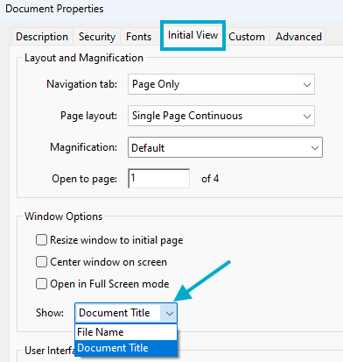
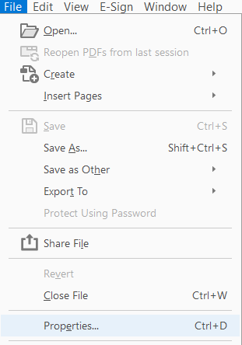
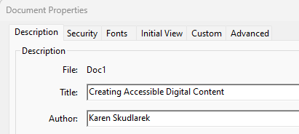
Document Title & Author
File > Properties > Initial View > Show > Document Title
Set Initial View to “Document Title” in Document Properties.
ITS Accessibility – Create Inclusive & Accessible Experiences

Slide 6

Tags in PDF Documents
What to Expect & Tagging Guides

Slide 7
Tags (1/2)
Store Metadata
Organize Information
Tags contain information on objects and their relation to one another.
Allows screen readers and similar to interpret and parse information.
Many Options
Group Tags
Websites have over 100 types of tags, while PDFs have about 40 types.
Container tags like Document help to organize child tags such as Paragraph.
ITS Accessibility – Create Inclusive & Accessible Experiences

Slide 8
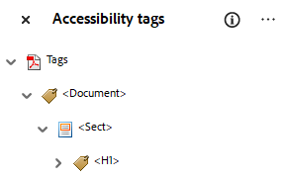
Tags 2/2
Good-to-Know
Common Tags
Document, Section, Part, Article are container tags that screen readers ignore but
These are often used by remediators.
<Document> is always the root tag.
InDesign gives more Article tags while PowerPoint gives more Section tags.
Document (as root tag)
Headings (1-6) for navigation with screen readers
Paragraph
Figure
Link
Nested Tags
List (L, LI, Lbl, Lbody)
Table (THead, TR, TH, TD, TBody)
ITS Accessibility – Create Inclusive & Accessible Experiences
Notes:
So what is enough color contrast? The Web Content Accessibility Guidelines or WCAG, require that the color contrast between the foreground color and the background color is 4.5 to 1. If the font is 18 point font or higher, the threshold can be lower at three to one. I recommend always using the 4.5 to 1 ratio no matter the size of the font. There are many tools available to help make these calculations.

Slide 9
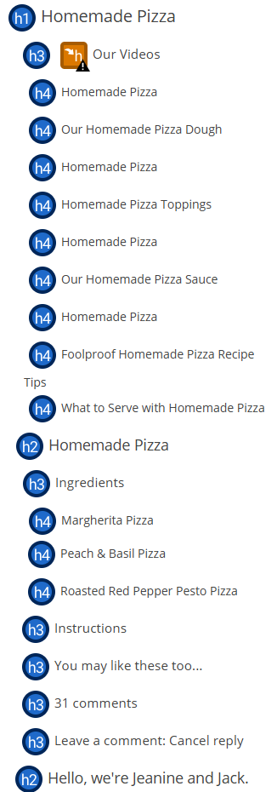
Unorganized & Unclear Headings
Headers should follow H1-H6 nesting structure.
Titles for headers need to be distinct.
Only one <H1> is permitted within a document.
ITS Accessibility – Create Inclusive & Accessible Experiences

Slide 10
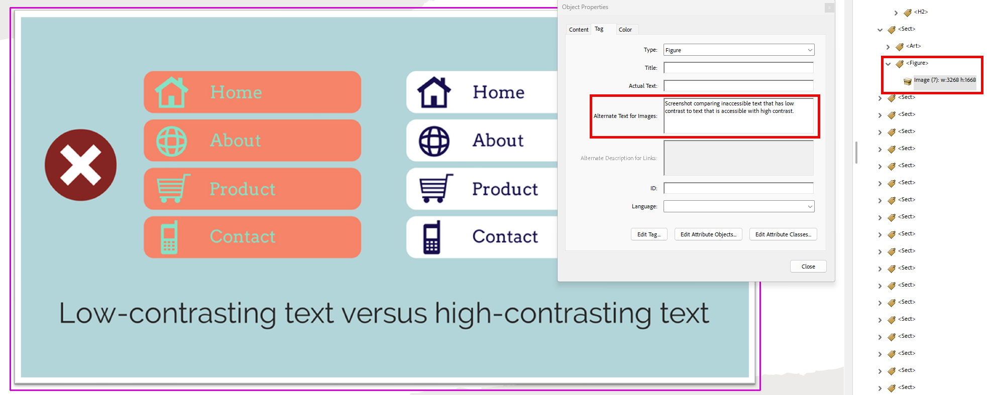
Figure Tags
Tag example images with <Figure>.
ITS Accessibility – Create Inclusive & Accessible Experiences

Slide 11
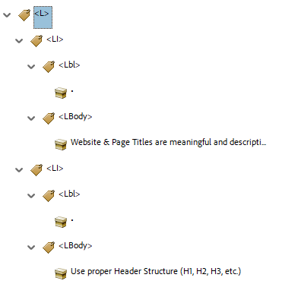
List Tags
L (List)
LI (List Item)
Lbl (Label – bullet, number, etc.)
Lbody (text of the list item)
LI
Lbl
Lbody
ITS Accessibility – Create Inclusive & Accessible Experiences

Slide 12
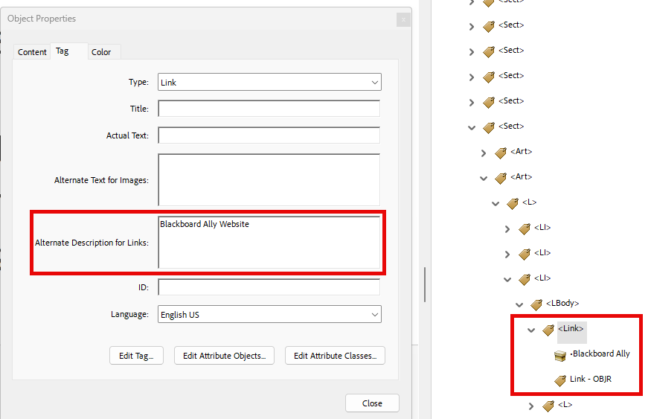
Descriptive Tagged Hyperlinks
Screen reader users navigate websites tabbing link to link.
Write text display to indicate link page.
Do not use “click here,” “learn more,” “read more” as text display.
Example:
BlackBoard Ally
Don’t underline text that isn’t a link.
Keyboard only users may think it’s a link and can’t access it by tabbing.
ITS Accessibility – Create Inclusive & Accessible Experiences

Slide 13
True Tables
Use only data for tables.
Designate top row as the header for each column and/or row
Table must start with a <Table> tag.
One table row (<TR>) tag per row, including header row(s).
All headers should be retagged as <TH>, whether a row or column.
ITS Accessibility – Create Inclusive & Accessible Experiences
Notes:
Select the <Table> tag to expand a list of table rows (<TR>). You should have one <TR> tag for each row in the table including the header row(s).
If the first row of the table is a header row, double click on each column (<TD>) to rename the element as a <TH>
The first column of the table may also be used as a header. If so, expand each of the remaining Table Rows (<TR>). In each table row, change the first <TD> tag to a <TH> tag to mark it as a table header.

Slide 14
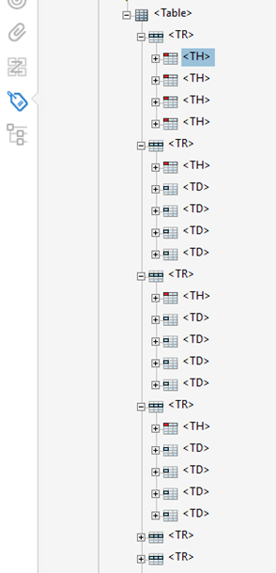
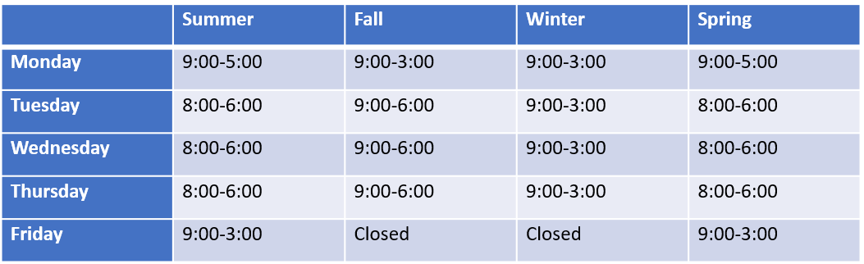
Tagged Table Example
First <TR> tagged row contains <TH> tags for headers.
Remaining <TR> tags include data tagged as <TD> with first column all marked as <TH>.
ITS Accessibility – Create Inclusive & Accessible Experiences
Notes:
The first TR tag is the first table row that contain headers so each item below it is TH (table header)
The remaining TR tags are the rows below the first column of headers and the first column is marked as a header TH.
So, the first tag under the remaining TR is TH for the heading in the first column

Slide 15
PDF Accessibility Checkers
PDF Accessibility Checker 2024 (free) for Windows only
Blackboard Ally (HuskyCT)
Can upload files into HuskyCT with course or organization access.
Email karen.skudlarek@uconn.edu for course access, if necessary.
Ally will assign an accessibility score to any uploaded file.
Scans PDF, DOCx, and PPTx.
Acrobat Pro
Doesn’t check reading order or color contrast.
Has an Optical Character Recognition (OCR) option to extract text.
Very technical.
ITS Accessibility – Create Inclusive & Accessible Experiences

Slide 16
Accessible PDF Checklist
Add accessibility tools to Acrobat Pro.
Presence of a document title.
Alt text for images (verify auto generated alt text).
Descriptive hyperlinks with correct tagging.
True tables with correct tagging.
Adequate color contrast (Acrobat Pro does not check for color contrast)
Proper Tag Tree (Headers, Figures, Paragraphs, Links, Tables, Lists).
Logical Reading Order for screen readers and tabbing.
ITS Accessibility – Create Inclusive & Accessible Experiences

Slide 17

Thank You!
ACCESSIBLE PDFs
UConn ITS Accessibility
accessibility.its.uconn.edu

Slide 18
University of Connecticut Wordmark

