Slide 1
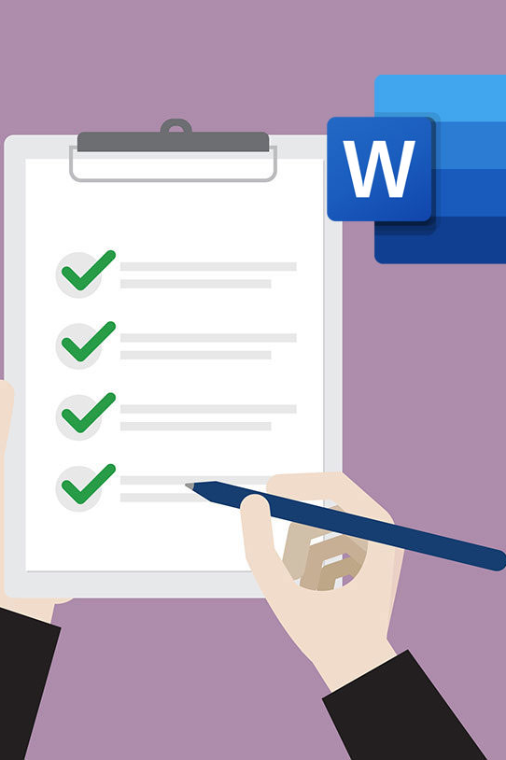
Accessible Word Documents
ITS ACCESSIBILITY
Create Inclusive & Accessible Experiences
December 2025
Notes:
Welcome to Accessible Word Documents. This workshop assumes that you have reviewed the accessible colors and accessible images workshops.

Slide 2
Improving Word Accessibility
Add a document title and author.
Use accessible fonts (sans serif) like Arial, Calibri, and Verdana.
Ensure alt text and adequate color contrast in the document.
Hyperlinks should be descriptive.
Include headers and styles,
True tables need to have headers.
Avoid justified (centered) formatting for consistency.
Use accessibility checkers.
Create PDFs from copiers.
ITS Accessibility – Create Inclusive & Accessible Experiences

Slide 3
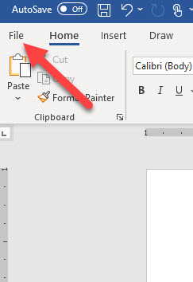
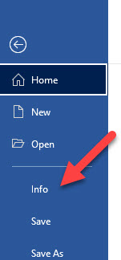
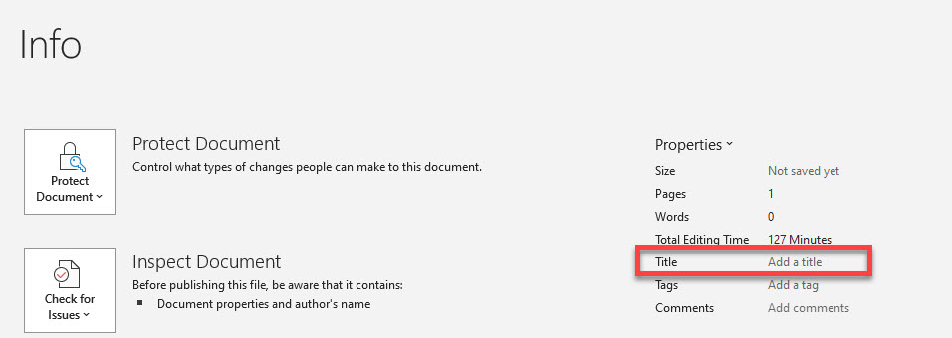
Document Title & Author
ITS Accessibility – Create Inclusive & Accessible Experiences
Notes:
If a file doesn’t have a title, its filename will be used instead. Filenames often include acronyms or abbreviations, which can be confusing when read by a screen reader. To ensure accessibility, every file—such as Word documents, PowerPoint presentations, Excel spreadsheets, and PDFs—must have a proper title. Click File > Info and include a title.

Slide 4
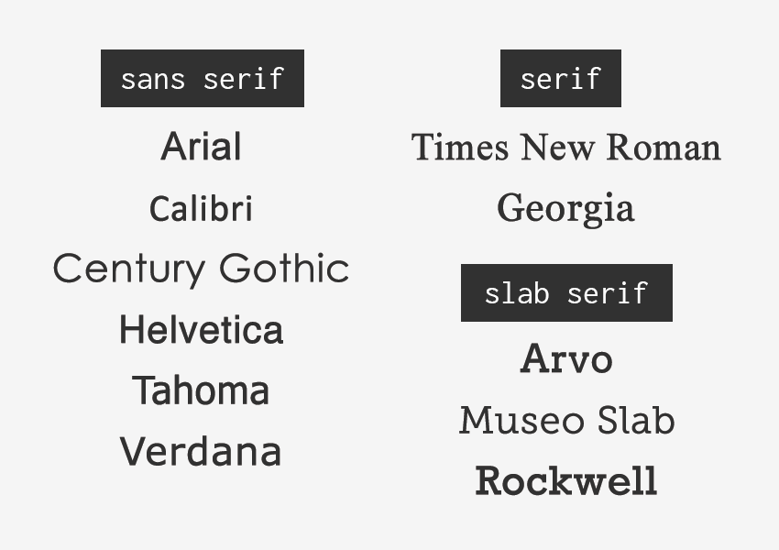
Accessible Fonts (sans-serif)
Good choices are:
  Arial
  Calibri
  Verdana
Use font size 12 or higher.
Bold with Strong style.
Italicize with Emphasis style.
ITS Accessibility – Create Inclusive & Accessible Experiences
Notes:
Use accessible fonts, such as sans-serif. Serifs are small strokes at the ends of letters. Sans-serif fonts don’t have serifs making them easier to read and more accessible. This improves legibility for people with visual impairments, dyslexia, or cognitive disabilities and ensures text displays clearly on screens. Some examples are Arial, Calibri and Verdana

Slide 5
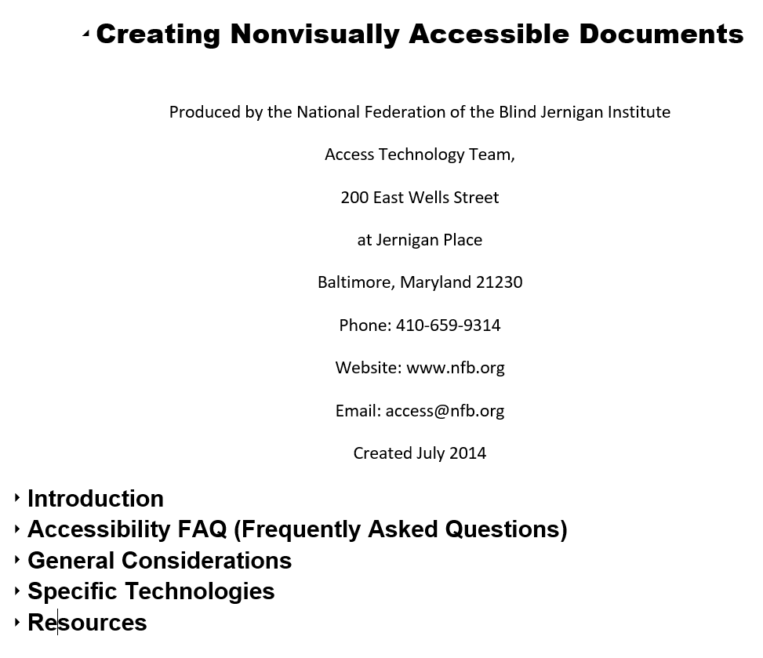
Headers & Styles
Tip: Turn on Navigation Pane in Word to see the structure. Click on View in the Ribbon and turn it on under Show section
ITS Accessibility – Create Inclusive & Accessible Experiences
Notes:
Headings provide structure and organization to a document, making it easier for screen readers to navigate. They allow users with visual impairments to jump between sections quickly instead of reading line by line. Proper heading styles (Heading 1, Heading 2, etc.) create a logical hierarchy that improves readability and ensures that assistive technologies can interpret the document correctly. There is only one heading one in any file or webpage. The main sections are heading twos and subsections are heading threes.

Slide 6
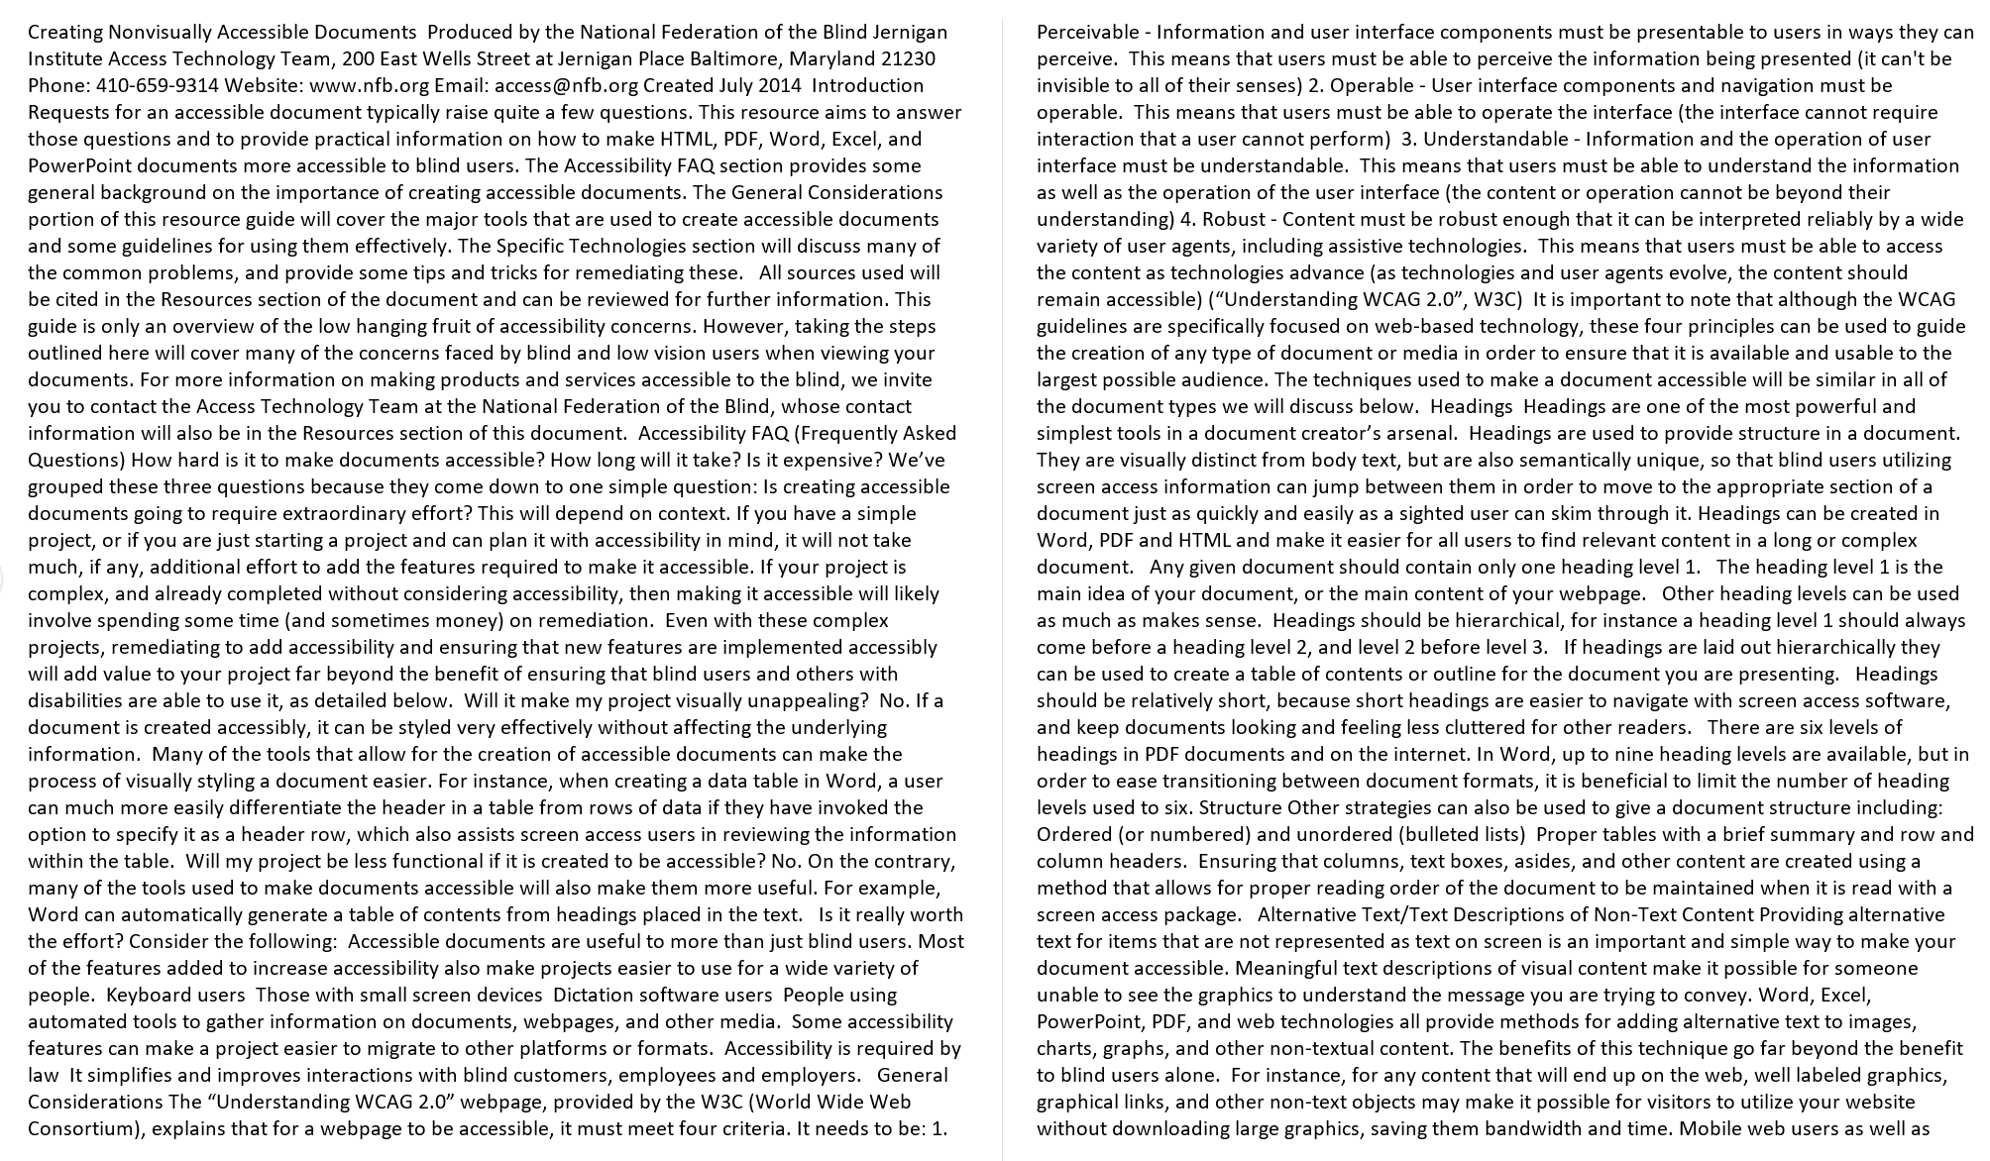
Inaccessible File
This file has far too many words in a huge block with no line breaks.
ITS Accessibility – Create Inclusive & Accessible Experiences
Notes:
This example has no headings. Sighted readers can quickly scan a document by looking for headings, which are usually bold and larger than the surrounding text. Without headings, finding specific information becomes difficult and may require reading the entire document. For someone using a screen reader, the experience is similar: they rely on headings to navigate by listening. If headings aren’t used, they must listen to the entire document to find what they need.

Slide 7
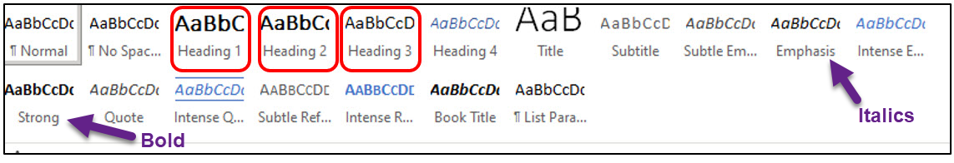
Word Headings
Use the Styles found in the Home tab of the Ribbon.
Right-click on “Heading” in the Styles panel to modify its format.
Emphasis Style is for italics and Strong is for bold.
ITS Accessibility – Create Inclusive & Accessible Experiences
Notes:
The headings are found in the ribbon under styles. A heading can be modified by right mouse clicking on it and click update heading to match selection or click modify. Using the styles emphasis for italics and strong for bold is important because they provide visual cues that help convey meaning and structure. Screen readers announce these styles, allowing users with visual impairments to understand which text is highlighted or emphasized. Avoid clicking the I or B shortcut icons in the ribbon because they don’t apply the style required for screen readers.

Slide 8
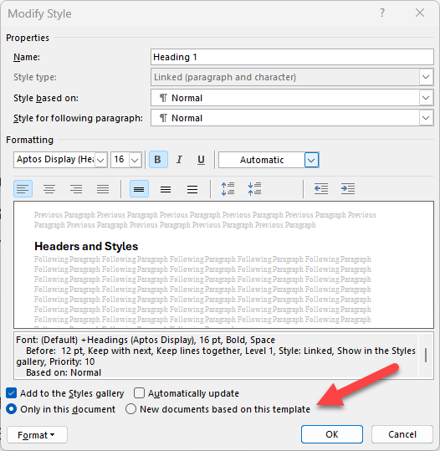
Blank Templates: Normal.dotm
Blank templates in Word open as Normal.dotm files.
Select “New documents based on this template” to apply Style changes.
Create custom templates using different Heading Styles for various documents.
ITS Accessibility – Create Inclusive & Accessible Experiences
Notes:
When you open Word and start with the Blank template, it uses the Normal.dotm file. If you modify any Styles in this template and choose “New documents based on this template,” those changes are saved to Normal.dotm, affecting all future blank documents. If you need different heading styles for various types of documents, such as a meeting agenda, you can create custom templates instead of changing the default.

Slide 9
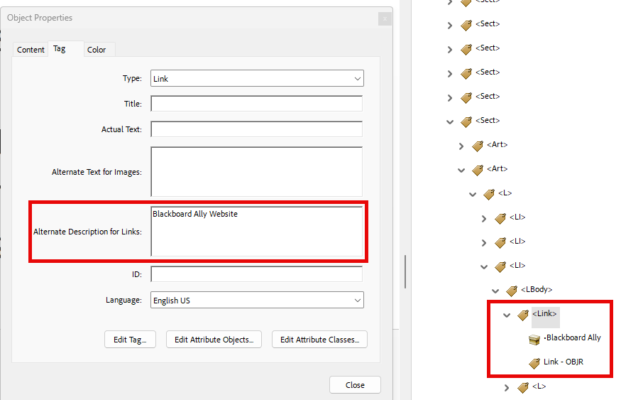
Descriptive Tagged Hyperlinks
Screen reader users navigate websites tabbing link to link.
Write text display to indicate link page.
  Do not use “click here,” “learn more,” “read more” as text display.
Example:
  BlackBoard Ally
Don’t underline text that isn’t a link.
  Keyboard only users may think it’s a link and can’t access it by tabbing.
ITS Accessibility – Create Inclusive & Accessible Experiences
Notes:
Sighted users can visually scan a document or webpage to identify links, which are usually bold and underlined. Users who are blind rely on screen readers and navigate by pressing the Tab key to move through links. Screen readers only announce the link text, not the surrounding content. If a link says “Click here,” the user has no idea where it leads. Instead, use descriptive link text, such as “Download the Accessibility Guide.”
This is important: Do not underline text that isn’t a hyperlink. Sighted users who can’t use a mouse and can only navigate with a keyboard may assume it’s a link and try to tab to it, which can cause confusion.

Slide 10
True Tables in Word
Use only data for tables
Designate the first row and/or column as headers.
  Top row should be column headers.
  First column should be row headers.
  Be sure to turn on Repeat Header Row.
Add alt text to the table.
Split or merged cells and nested tables are inaccessible in Word.
  Must use Acrobat Pro to remediate.
Check tab navigation (left to right and down).
ITS Accessibility – Create Inclusive & Accessible Experiences
Notes:
When creating accessible tables, start by using tables only for data—not for layout purposes. Always designate the first row and, if needed, the first column as headers. The top row should contain column headers, and the first column should contain row headers. Make sure to turn on the “Repeat Header Row” option so headers remain visible when scrolling.
Add alt text to the table to describe its purpose and content for screen reader users. Finally, avoid split or merged cells and nested tables because these become inaccessible when the document is saved as a PDF. If they’re created, you must use Acrobat Pro to remediate the table in the file.

Slide 11
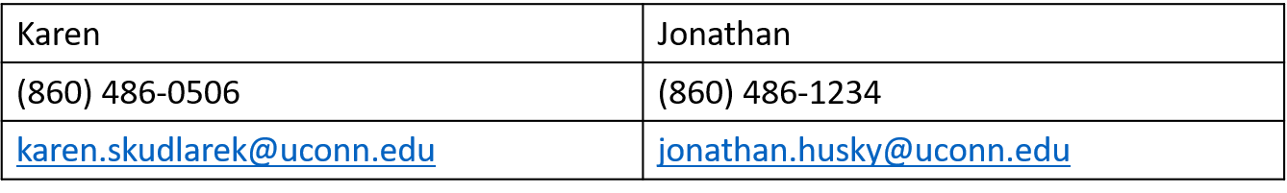
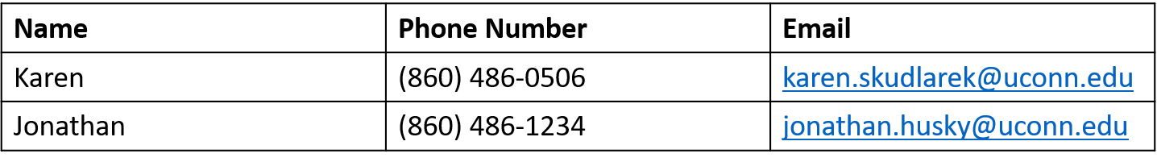
True Tables
Inaccessible Table
The presence of headings is the primary difference between an inaccessible and accessible true table.
Accessible Table
ITS Accessibility – Create Inclusive & Accessible Experiences
Notes:
Here are two examples of tables. The first is inaccessible because it was used only for layout purposes and doesn’t contain headings. Tables are read from left to right and down. If this table had more rows, it would be very difficult to understand which phone number is associated with which person. The table below it is accessible because it has headers and the data is same for each column making it much easier for someone with a screen reader to access the data.

Slide 12
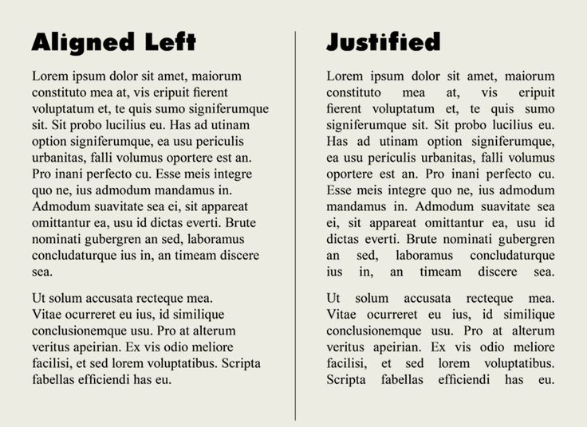
Avoid Justified (Center) Format
Makes text visually appealing with perfect margins but creates inconsistent spacing.
Assistive technologies (AT) like magnification will expose considerable white space.
  Can cause disarray between words and characters.
ITS Accessibility – Create Inclusive & Accessible Experiences
Notes:
Avoid using Justify format for paragraphs. Although it allows the text to appear as a single block with perfect margins, it also creates inconsistent spacing, which can force the reader’s eyes to “jump" when reading. This becomes a serious issue when using assistive technologies such as screen readers. Many people with vision disabilities use screen magnifiers or enlarge web content by “zooming in" on the page. If text is justified, these users may see large, empty spaces between (or within) words — or the words may run together in a confusing mess of characters. Fully justified text can create uneven spaces between words and letters, making it difficult for those with dyslexia.

Slide 13
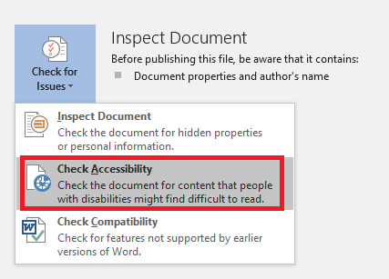
Accessibility Checkers
Microsoft Office
  Review > Check Accessibility
  Turn on Navigation Pane.
HuskyCT/Blackboard Ally
  For courses and websites.
PDF/UA PDF Checker 2024
  More technical but provides insight into issues needing remediation.
ITS Accessibility – Create Inclusive & Accessible Experiences
Notes:
Use the Accessibility Checker in Microsoft Office applications, located under the Review tab by selecting Check Accessibility. In HuskyCT, Blackboard Ally automatically checks Word, PowerPoint, and PDF files for accessibility issues. If a file is saved as a PDF, use the PDF Checker 2024 application for Windows to verify its accessibility.

Slide 14
Accessible Word Checklist
Presence of document title and author.
Accessible fonts like Arial, Calibri, Verdana were used.
Navigation pane was open to guide users.
Alt text exists for images and tables.
Clear headers and other styles with adequate color contrast.
Hyperlinks are descriptive.
True tables includes headers using repeat header row.
Check accessibility with Office and/or Blackboard Ally.
ITS Accessibility – Create Inclusive & Accessible Experiences
Notes:
You can use this checklist to make sure that you’re meeting the accessibility requirements for Word documents.

Slide 15

Thank You!
ACCESSIBLE WORD DOCUMENTS
UConn ITS Accessibility
accessibility.its.uconn.edu
Notes:
Thank you for your time and please, check out the other workshops related to accessibility.

Slide 16
University of Connecticut Wordmark

